Slide 1
Computer Networks ( KCS-603 )
UNIT-I

Slide 2
Computer Network
A computer network is a set of communicating devices connected together by communication links for the purpose of sharing resources.
Shared resources include printer, scanner and file servers etc.

Slide 3
You Require …
Components of a Computer Network

Slide 4
Benefits of Computer Network
Resource and load sharing
Programs do not need to run on a single machine
Reduced cost
Several machines can share printers, tape drives, etc.
High reliability
If a machine goes down, another can take over
Powerful Communication Medium

Slide 5
Applications of Computer Network
Business Applications
Home Applications
Access to remote information
Person-to-person communication
Interactive entertainment
Electronic commerce
Mobile Users
Social Issues

Slide 6
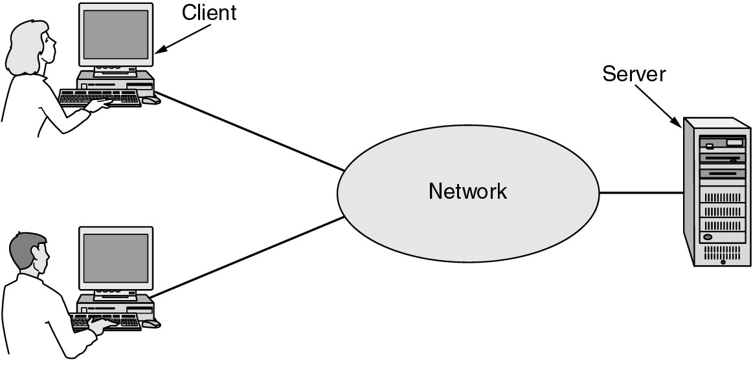
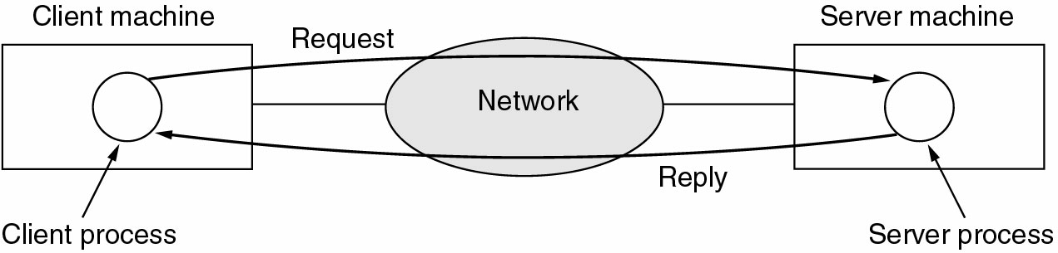
Business Applications of Networks
A network with two clients and one server. Client Server Model(Request and Reply)

Slide 7
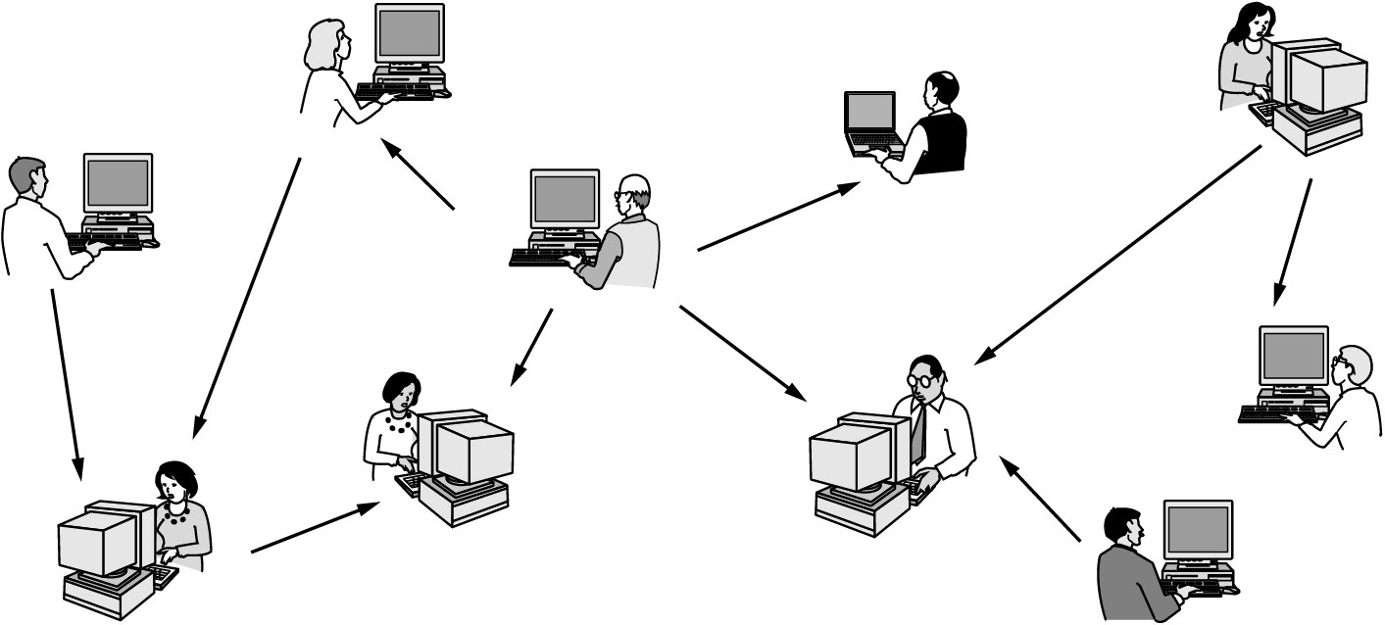
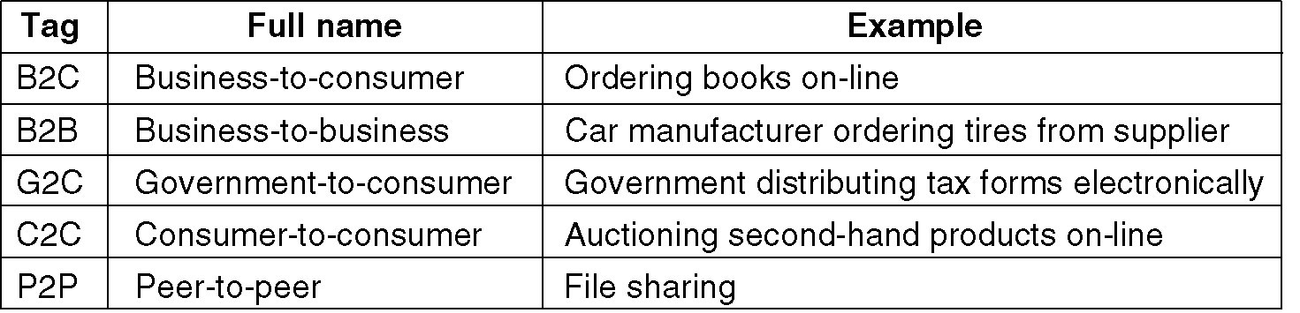
Home Network Applications
Home Network(Peer to Peer) Home Network(E-Commerce)

Slide 8
Applications of Computer Network
Business Applications
Resource Sharing: The goal is to make all programs, equipments, and especially data, available to anyone on the network without regard to the physical location of the resource and the user.
Server-Client model: One can imagine a company's information system as consisting of one or more databases and some number of employees who need to access them remotely. In this model, the data is stored on powerful computers called servers. Often these are centrally housed and maintained by a system administrator. In contrast, the employees have simple machines, called clients, on their desks, with which they access remote data.
Communication Medium: A computer network can provide a powerful communication medium among employees. Virtually every company that has two or more computers now has e-mail (electronic mail), which employees generally use for a great deal of daily communication
E-Commerce: A goal that is starting to become more important is doing business with consumers over the Internet. Airlines, bookstores and music vendors have discovered that many customers like the convenience of shopping from home. This sector is expected to grow quickly in the future.

Slide 9
Applications of Computer Network (contd.)
Home Applications
Some of the most important uses of the Internet for home users are as follows:
Access to remote information
Person-to-person communication
Interactive entertainment
Electronic commerce

Slide 10
Criteria for a Data Communication Network
Delivery- Data Delivered by sender is received by intended receiver and no one else.
Accuracy- System must deliver the data correctly. Data that has been corrupted during transmission and left uncorrected are unusable.
Timeliness- System must deliver data in a timely manner. Data delivered late is useless. Deliver data, in same order as they are produced, without significant delay.
Jitter- Variation in packet delay time. Uneven delay in delivery of adjacent packets.

Slide 11
Criteria for a Data Communication Network
Performance
Performance is defined as the rate of transferring (error free) data. It is measured by the Response Time and Transit Time.
Transit Time-Time required for data to travel from one node to another.
Response Time is the elapsed time between the end of an inquiry and the beginning of a response. Request a file transfer and start the file transfer. Factors that affect Response Time are:
Number of Users: More users on a network - slower the network will run
Transmission Speed: speed that data will be transmitted measured in bits per second (bps)
Media Type: Type of physical connection used to connect nodes together
Hardware Type: Slow computers such as XT or fast such as Pentiums
Software Program: How well is the network operating system (NOS) written
Consistency
Consistency is the predictability of response time and accuracy of data.

Slide 12
Criteria for a Data Communication Network
Reliability
Reliability is the measure of how often a network is useable. MTBF (Mean Time Between Failures) is a measure of the average time a component is expected to operate between failures. Normally provided by the manufacturer. A network failure can be: hardware, data carrying medium and Network Operating System.
Recovery
Recovery is the Network's ability to return to a prescribed level of operation after a network failure. This level is where the amount of lost data is nonexistent or at a minimum. Recovery is based on having Back-up Files.
Security
Security is the protection of Hardware, Software and Data from unauthorized access. Restricted physical access to computers, password protection, limiting user privileges and data encryption are common security methods. Anti-Virus monitoring programs to defend against computer viruses are a security measure.

Slide 13
Protocols
A protocol is a predefined way of communicating
A set of ``rules'' between processes
Example: A ``person query'' protocol
I send you the name of a person
You send me a ``yes'' or a ``no'' depending upon whether that person lives in your house
If I send anything except a name, or you reply with anything except a ``yes'' or ``no'', the protocol is broken

Slide 14
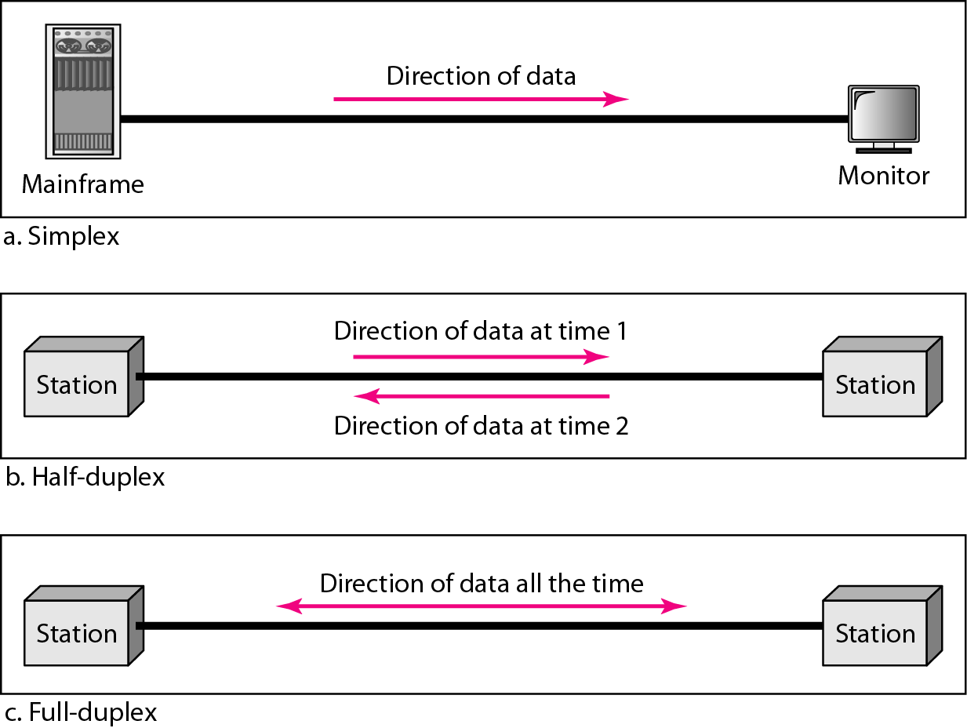
Data Flow(Simplex, Half-duplex and Full-duplex)
Example of simplex mode are: Keyboard and monitor.
Example of half duplex mode is: Walkie-Talkies.
Example of full duplex mode is:Telephone.

Slide 15
Types of Connection and Types of Transmission
Type of Connection
Point to Point - single transmitter and receiver. Bandwidth Dedicated between the two connections.
Multipoint - multiple recipients of single transmission. Bandwidth Shared between all stations on that line.
Types of Transmission(Basic)
Unicast-one sender to one receiver.
Multicast-one sender to many receivers but not all. Sending to a group having a multicast address designated by a group ID.
Broadcast-one sender to all receivers.
Types of Transmission(Derived)
Anycast- one-to-nearest association; datagrams are routed to a single member of a group of potential receivers that are all identified by the same destination address.
Geocast-delivery of information to a group of destinations in a network identified by their geographical locations. It is a specialized form of multicast addressing used by some routing protocols for mobile ad hoc networks.

Slide 16
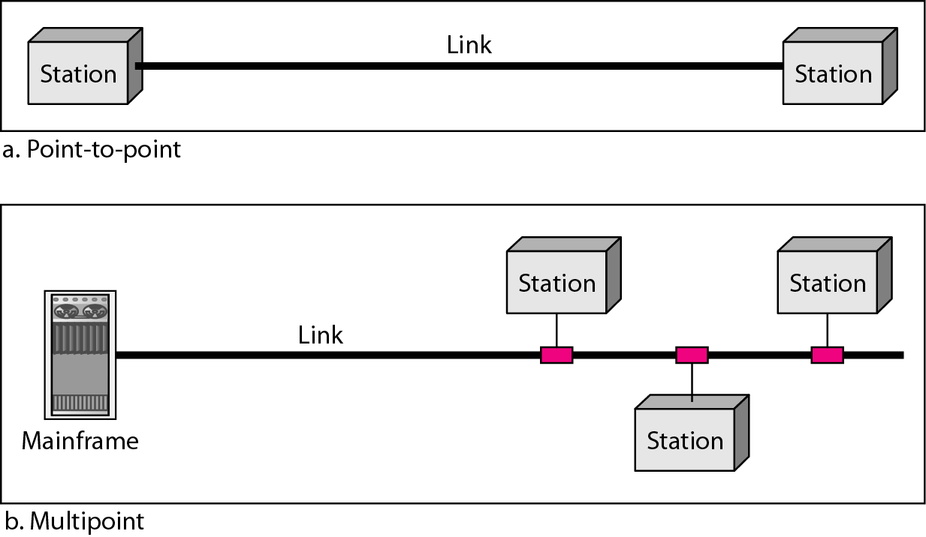
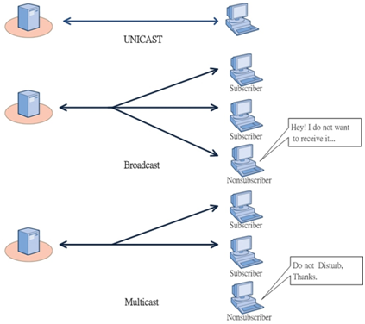
Types of Connection and Types of Transmission

Slide 17
Line Configuration
Point to Point
Multipoint

Slide 19
Network Hardware
Local Area Networks
Metropolitan Area Networks
Wide Area Networks
Wireless Networks
Wireless LANs
Wireless WANs
Home Networks
Computers (desktop PC, PDA, shared peripherals
Entertainment (TV, DVD, VCR, camera, stereo, MP3)
Telecomm (telephone, cell phone, intercom, fax)
Appliances (microwave, fridge, clock, furnace, airco)
Telemetry (utility meter, burglar alarm, babycam).
Internetworks

Slide 20
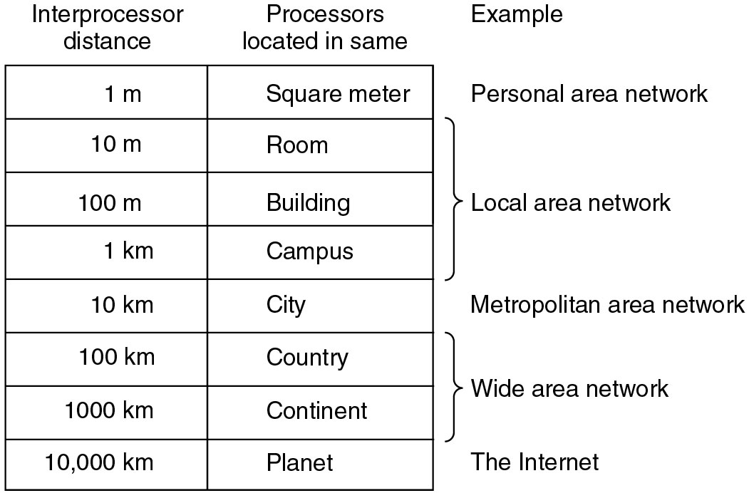
Classification of Networks By Scale

Slide 21
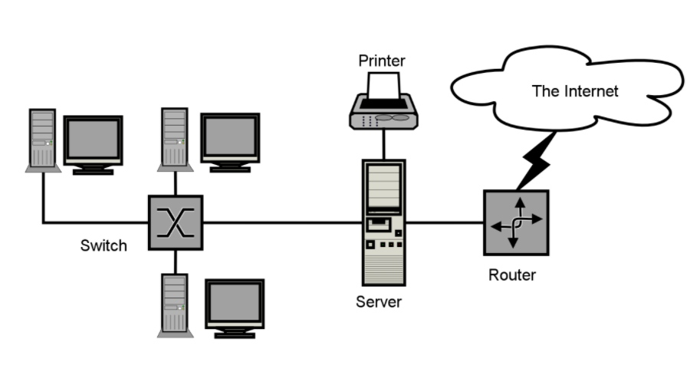
Local Area Networks
A local area network, or LAN, consists of a computer network at a single site, typically an individual office building. A LAN is very useful for sharing resources, such as data storage and printers. LANs can be built with relatively inexpensive hardware, such as hubs, network adapters and Ethernet cables.
The smallest LAN may only use two computers, while larger LANs can accommodate thousands of computers. A LAN typically relies mostly on wired connections for increased speed and security, but wireless connections can also be part of a LAN. High speed and relatively low cost are the defining characteristics of LANs.

Slide 22
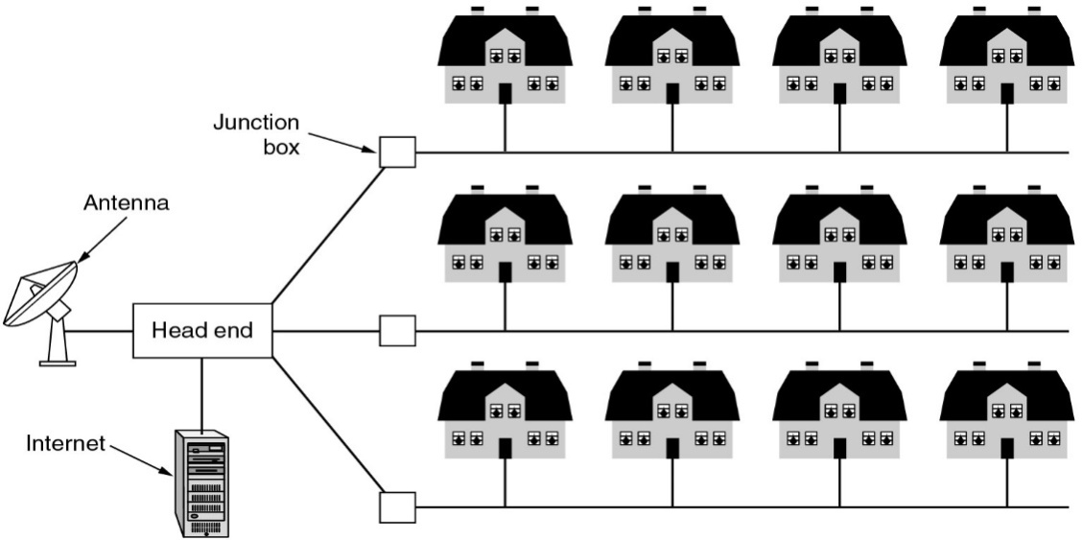
Metropolitan Area Networks - Cable TV
A metropolitan area network, or MAN, consists of a computer network across an entire city, college campus or small region. A MAN is larger than a LAN, which is typically limited to a single building or site. Depending on the configuration, this type of network can cover an area from several miles to tens of miles. A MAN is often used to connect several LANs together to form a bigger network. When this type of network is specifically designed for a college campus, it is sometimes referred to as a campus area network, or CAN.

Slide 23
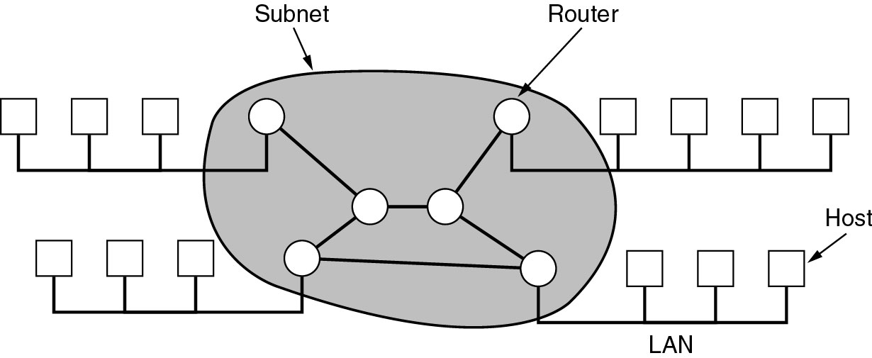
Wide Area Networks
A computer network that spans a relatively large geographical area, generally having a radius of more than 1 km. . Typically, a WAN consists of two or more local-area networks (LANs). Computers connected to a wide-area network are often connected through public networks, such as the telephone system. They can also be connected through leased lines or satellites.

Slide 24
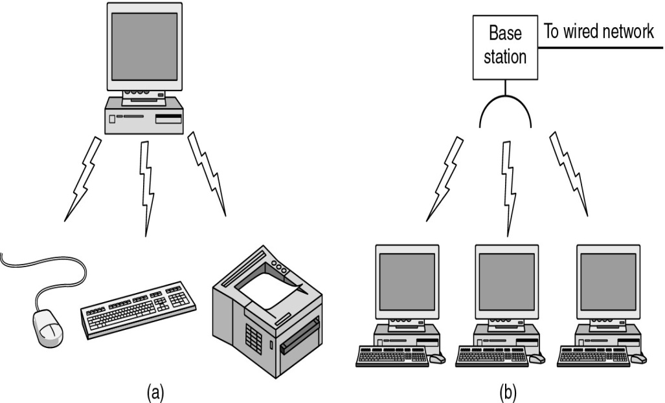
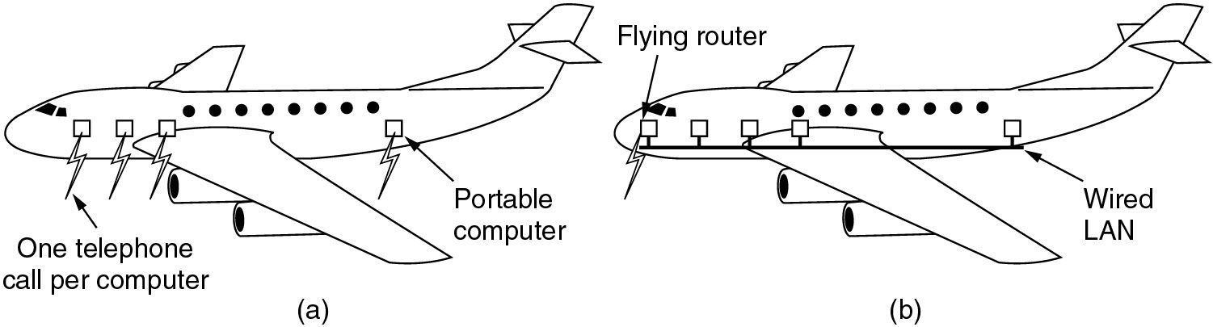
Wireless Networks
(a) Bluetooth configuration
(b) Wireless LAN
(a) Individual mobile computers
(b) A flying LAN

Slide 25
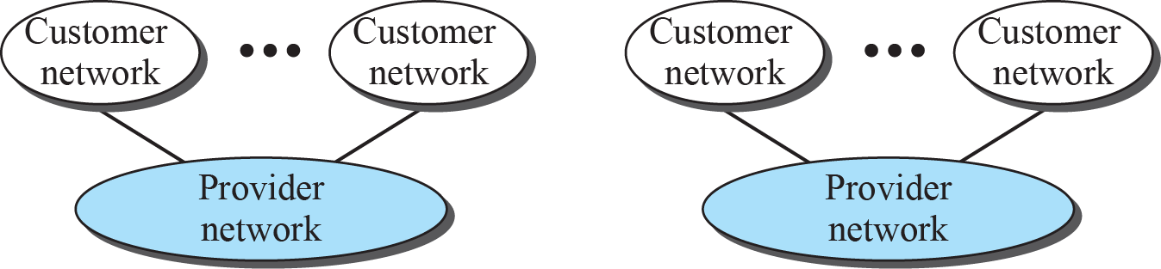
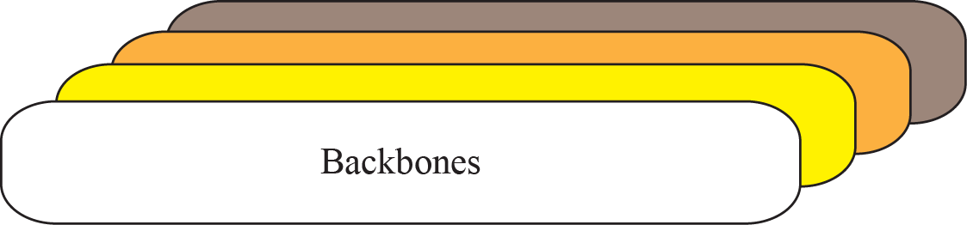
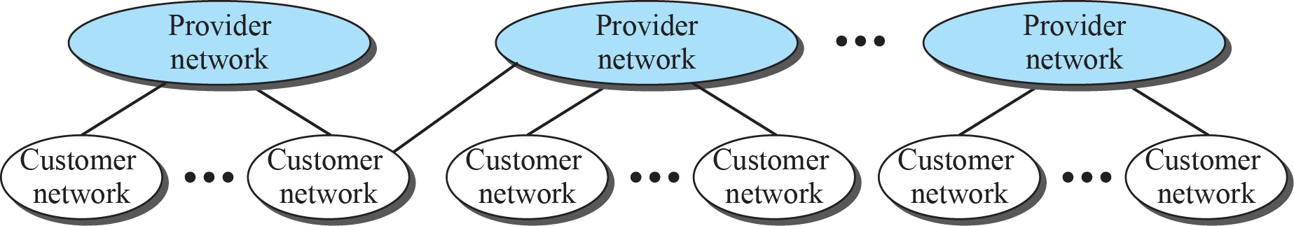
The Internet today
The Internet today is an internetwork that allows any user to become part of it. The user, however, needs to be physically connected to an ISP. The physical connection is normally done through a point-to-point WAN.
1.25

Slide 26
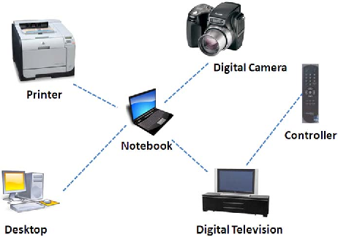
PAN (Personal Area Network)
Some newer types of the networks based on their reach
A personal area network (PAN) is a computer network used for data transmission amongst devices such as computers, telephones, tablets, personal digital assistants, fax machines and printers, that are located close to a single user.

Slide 27
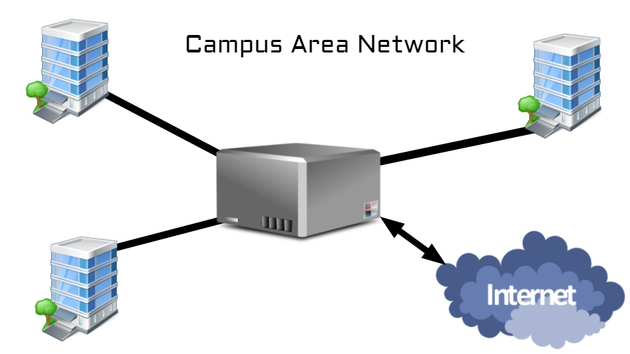
CAN (Campus Area Network)
A network infrastructure covering the school, university, or a corporate premises can be dubbed as campus area network. It can comprise of several LANs, a central firewall, and connected to the internet using a leased line or any other means.

Slide 28
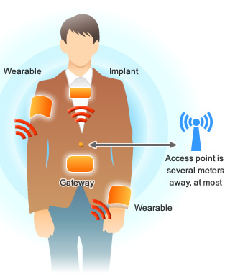
BAN (Body Area Network)
Related to PAN ( as a subnetwork ), another term BAN is used for using wearable devices like smartwatches, fitness bands, biometric RFID implants, and medical devices placed inside the body like pacemakers. Wireless BAN is the primary form used to created such networks. It is defined as per the IEEE 802.15.6 standard which describes a short-range, extremely low power wireless communication within or in a vicinity of the human body.
Wireless BAN can work together with PAN technologies. For instance, a Bluetooth-connected smartphone can be used to sync data from wearables and various sensors present in the body.

Slide 29
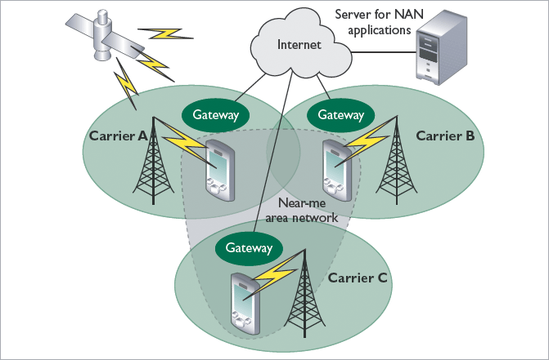
NAN (Near-Me Network)
Although it sounds totally unfamiliar, you use Near-me network almost every day. Remember chatting with your friends on Facebook while all of you were sitting in the same room. You were part of a NAN, even though you might be on the networks of different carriers.
A message from your device would traverse all the way to Facebook servers over the internet come to your friend’s device sitting right next to you. In a logical way, both the device are on some sort of network. Basically, the criteria for the devices is to lie in proximity. They don’t need to be connected to the same network. For instance, they can be connected via WiFi, cellular, etc.

Slide 30
Brief description of some other terms discussed in lectures
Firewall
A firewall is software used to maintain the security of a private network. Firewalls block unauthorized access to or from private networks and are often employed to prevent unauthorized Web users or illicit software from gaining access to private networks connected to the Internet. A firewall may be implemented using hardware, software, or a combination of both.

Slide 31
Proxy Server
Most large businesses, organizations, and universities these days use a proxy server. This is a server that all computers on the local network have to go through before accessing information on the Internet. By using a proxy server, an organization can improve the network performance and filter what users connected to the network can access.
A proxy server improves Internet access speeds from a network primarily by using a caching system. Caching saves recently viewed Web sites, images, and files on a local hard drive so that they don't have to be downloaded from the Web again. While your Web browser might save recently viewed items on your computer, a proxy server caches everything accessed from the network. Though this means super-fast access to Web pages, it also means users might not be seeing the latest update of each Web page.
The other main purpose a proxy server is to filter what is allowed into the network. While HTTP, FTP, and Secure protocols can all be filtered by a proxy server, HTTP is the most common. The proxy server can limit what Web sites users on the network can access. Many organizations choose to block access to sites with objectionable material, but other sites can be filtered as well.

Slide 32
IP Address
Most An IP address, short for Internet Protocol address, is an identifying number for a piece of network hardware. Having an IP address allows a device to communicate with other devices over an IP-based network like the internet.
Most IP addresses look like this: 151.101.65.121
MAC Address
MAC (Media Access Control) address [often referred to as hardware or physical address ] is your computer's unique hardware number. (On an Ethernet LAN, it's the same as your Ethernet address.)
When you're connected to the Internet from your computer (or host as the Internet protocol thinks of it), a correspondence table relates your IP address to your computer's physical (MAC) address on the LAN.
MAC addresses are 6-byte (48-bits) in length, and are written in MM:MM:MM:SS:SS:SS format as . The first 3-bytes are ID number of the manufacturer, which is assigned by an Internet standards body. The second 3-bytes are serial number assigned by the manufacturer.

Slide 33
IP Address
Most An IP address, short for Internet Protocol address, is an identifying number for a piece of network hardware. Having an IP address allows a device to communicate with other devices over an IP-based network like the internet.
Most IP addresses look like this: 151.101.65.121
MAC Address
MAC (Media Access Control) address [often referred to as hardware or physical address ] is your computer's unique hardware number. (On an Ethernet LAN, it's the same as your Ethernet address.)
When you're connected to the Internet from your computer (or host as the Internet protocol thinks of it), a correspondence table relates your IP address to your computer's physical (MAC) address on the LAN.
MAC addresses are 6-byte (48-bits) in length as 12-digit hexadecimal numbers, and are written in MM:MM:MM:SS:SS:SS format . The first 3-bytes are ID number of the manufacturer, which is assigned by an Internet standards body. The second 3-bytes are serial number assigned by the manufacturer. Sample MAC Address: 00:1C:B3:09:85:15

Slide 34
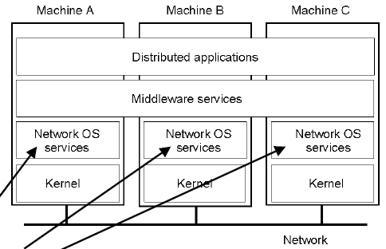
Distributed Systems
Distributed System built on top of Heterogenous Networks to provide Transparency to user.
Ex- Distributed Unix
Wide area network applications
email - electronic mail
bbs - bulletin board systems
netnews - group discussions on single subject
gopher - text retrieval service
WWW - world wide web
Banking applications like Finnacle, Bancslink.
Middleware Programming Platforms
CORBA
Java Sun-RPC

Slide 35
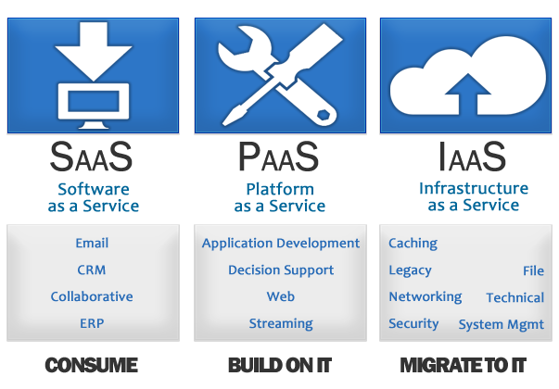
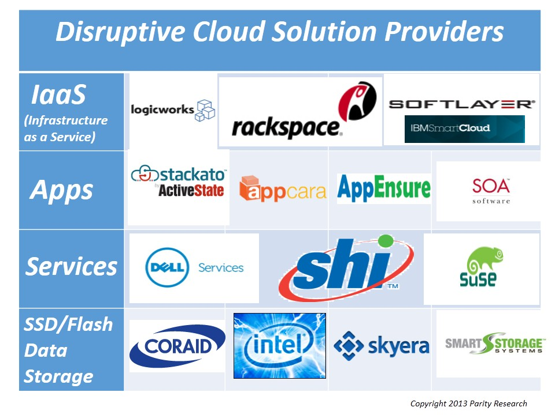
Cloud Computing
The practice of using a network of remote servers hosted on the Internet to store, manage, and process data, rather than a local server or a personal computer.
Ex-Microsoft Azure, Amazon Web Services, Oracle Web-Cloud etc.

Slide 36
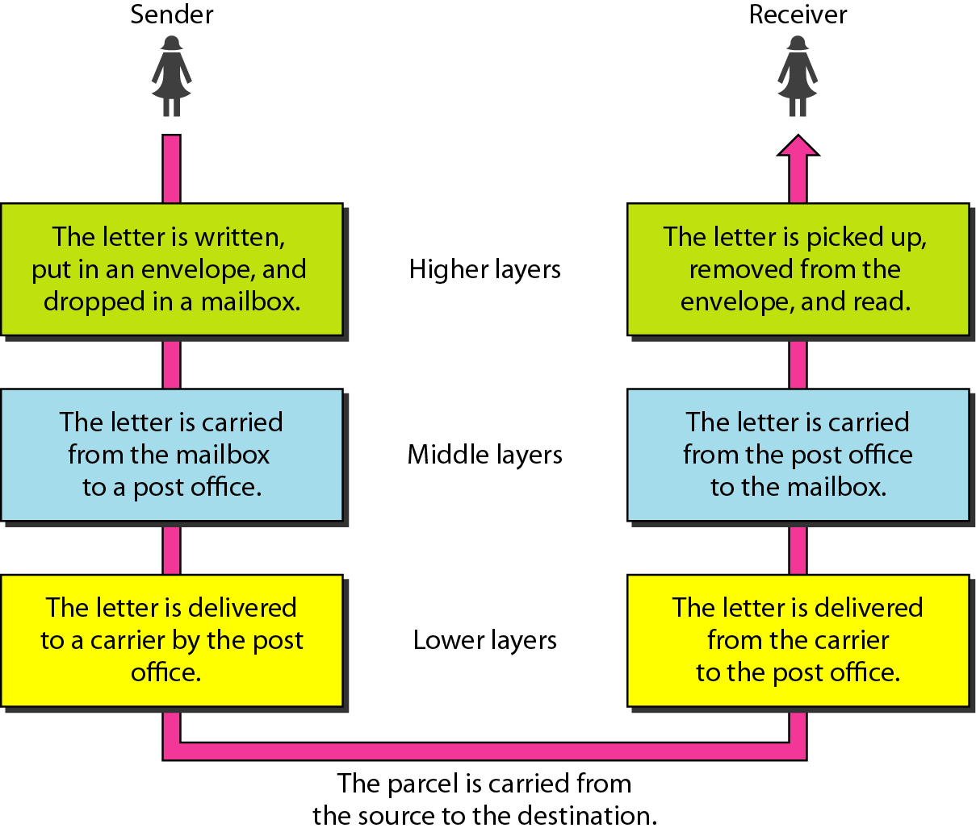
Basic Message Communication System
Tasks involved in sending a letter

Slide 37
Network Software
Protocol Hierarchies
Design Issues for the Layers
Connection-Oriented and Connectionless Services
Service Primitives
The Relationship of Services to Protocols

Slide 38
Network Software Protocol Hierarchies
To reduce the design complexity, most of the networks are organized as a series of layers or levels, each one build upon one below it.
The basic idea of a layered architecture is to divide the design into small pieces.
Each layer adds to the services provided by the lower layers in such a manner that the highest layer is provided a full set of services to manage communications and run the applications.
The benefits of the layered models are modularity and clear interfaces, i.e. open architecture and comparability between the different providers' components.

Slide 39
Element of layered model
A service is a set of actions that a layer offers to another (higher) layer.
Protocol is a set of rules that a layer uses to exchange information with a peer entity. These rules concern both the contents and the order of the messages used.
Between the layers service Interfaces are defined. The messages from one layer to another are sent through those interfaces.

Slide 40
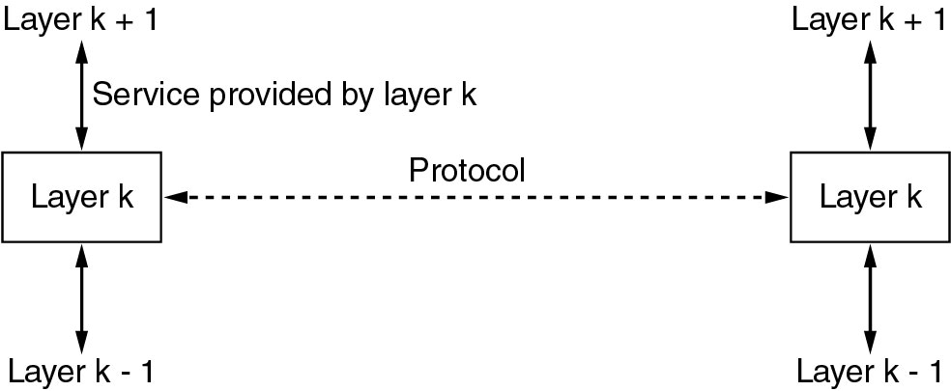
Services to Protocols Relationship
The relationship between a service and a protocol.
Layer k/k+1 Interface
Layer k-1/k Interface

Slide 41
Design Issues for the Layers
Addressing
Error Control
Flow Control
Multiplexing
Routing

Slide 42
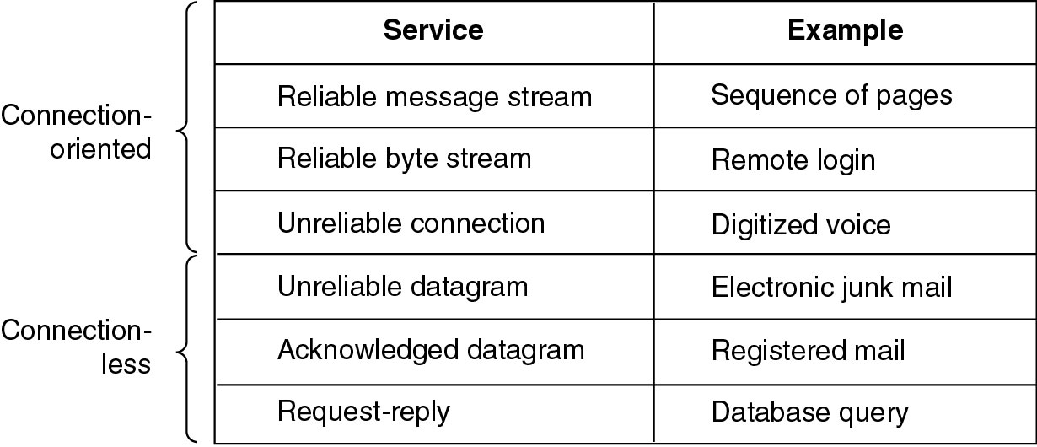
Connection-Oriented and Connectionless Services
Six different types of service.

Slide 43
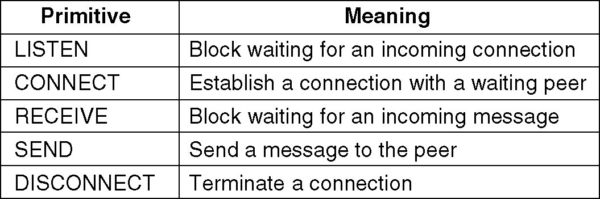
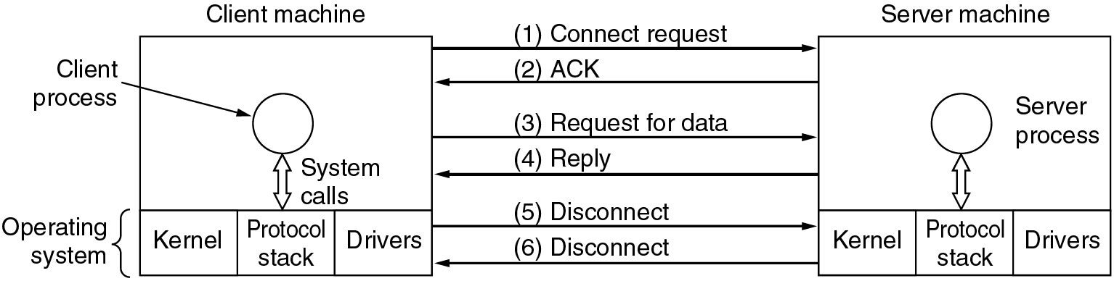
Service Primitives in a Connection-Oriented Service
Five service primitives for implementing a simple connection-oriented service.
Packets sent in a simple client-server interaction on a connection-oriented network.

Slide 44
Reference Models
The OSI Reference Model
The TCP/IP Reference Model
A Comparison of OSI and TCP/IP
A Critique of the OSI Model and Protocols
A Critique of the TCP/IP Reference Model

Slide 45
OSI and TCP/IP model-Brief History
Established in 1947, International Organization for Standardization (ISO) is a multinational body dedicated to worldwide agreement on international standards. An ISO standard that covers all aspects of network communications is the Open Systems Interconnection (OSI) model. It was first introduced in the late 1970s.
TCP/IP is a protocol suite used in the Internet today. It is a hierarchical protocol made up of interactive modules, each of which provides a specific functionality. The term hierarchical means that each upper level protocol is supported by the services provided by one or more lower level protocols. The original TCP/IP protocol suite was defined as four software layers built upon the hardware. Today, however, TCP/IP is thought of as a five-layer model.
ISO is the organization. OSI is the model.

Slide 46
Motivation behind layer model
To reduce the design complexity, most of the networks are organized as a series of layers or levels, each one build upon one below it.
The basic idea of a layered architecture is to divide the design into small pieces.
Each layer adds to the services provided by the lower layers in such a manner that the highest layer is provided a full set of services to manage communications and run the applications.
The benefits of the layered models are modularity and clear interfaces, i.e. open architecture and comparability between the different providers' components.

Slide 47
THE OSI MODEL
Established in 1947, the International Organization for Standardization (ISO) is a multinational body dedicated to worldwide agreement on international standards. An ISO standard that covers all aspects of network communications is the Open Systems Interconnection (OSI) model. It was first introduced in the late 1970s.
Note:
ISO is the organization.
OSI is the model.

Slide 48
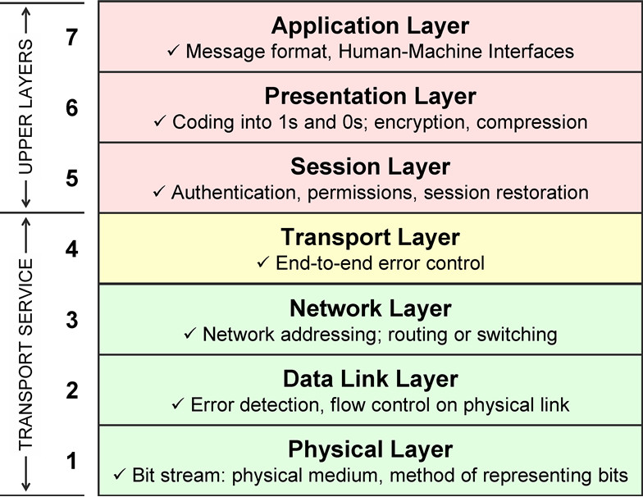
Seven layers of the OSI model

Slide 49
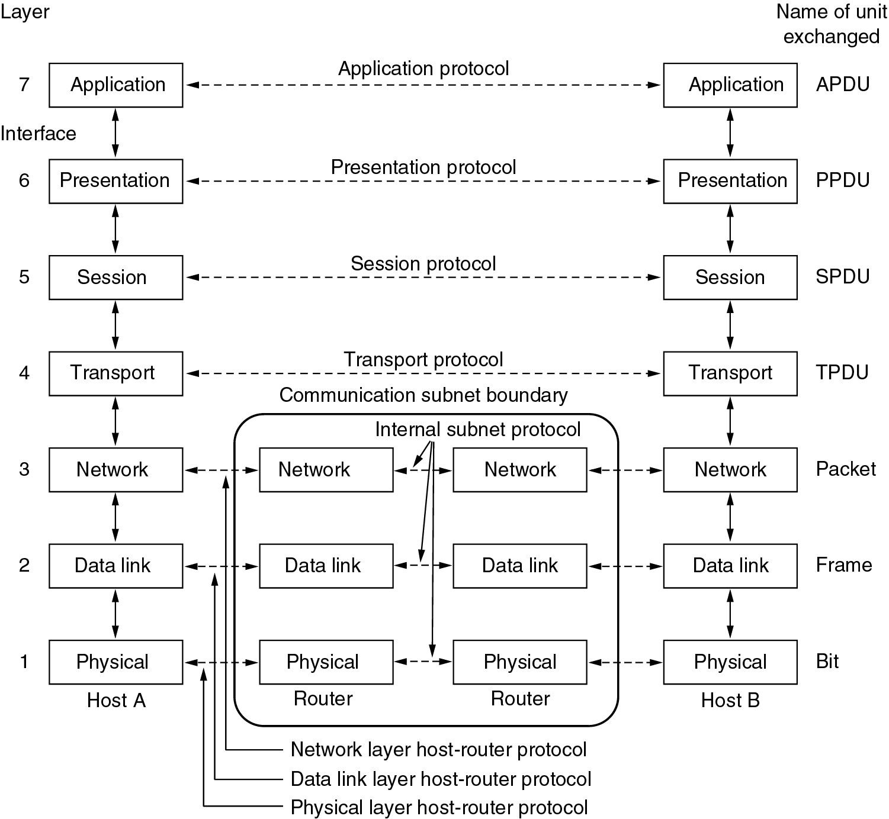
Reference Models-The OSI Reference Model
*PDU=
Protocol Data Unit
PDU has four fields:
1.the destination service access point
2.source service access point, 3.control field
and
4.information field.
(Segment)

Slide 50
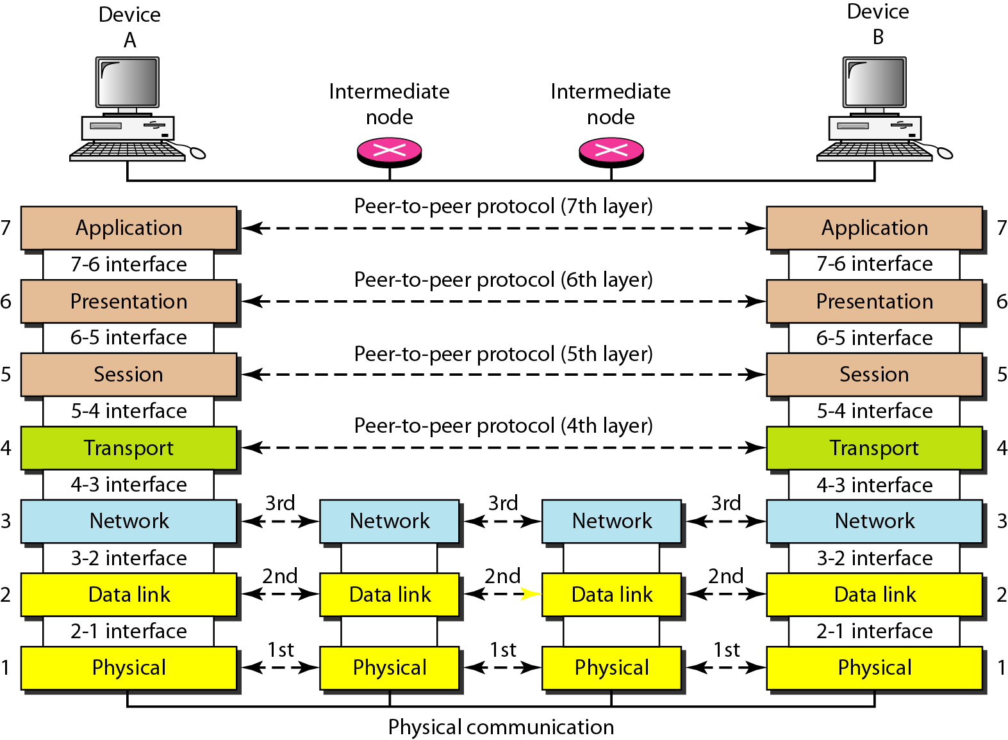
Interfaces b/w Layers

Slide 51
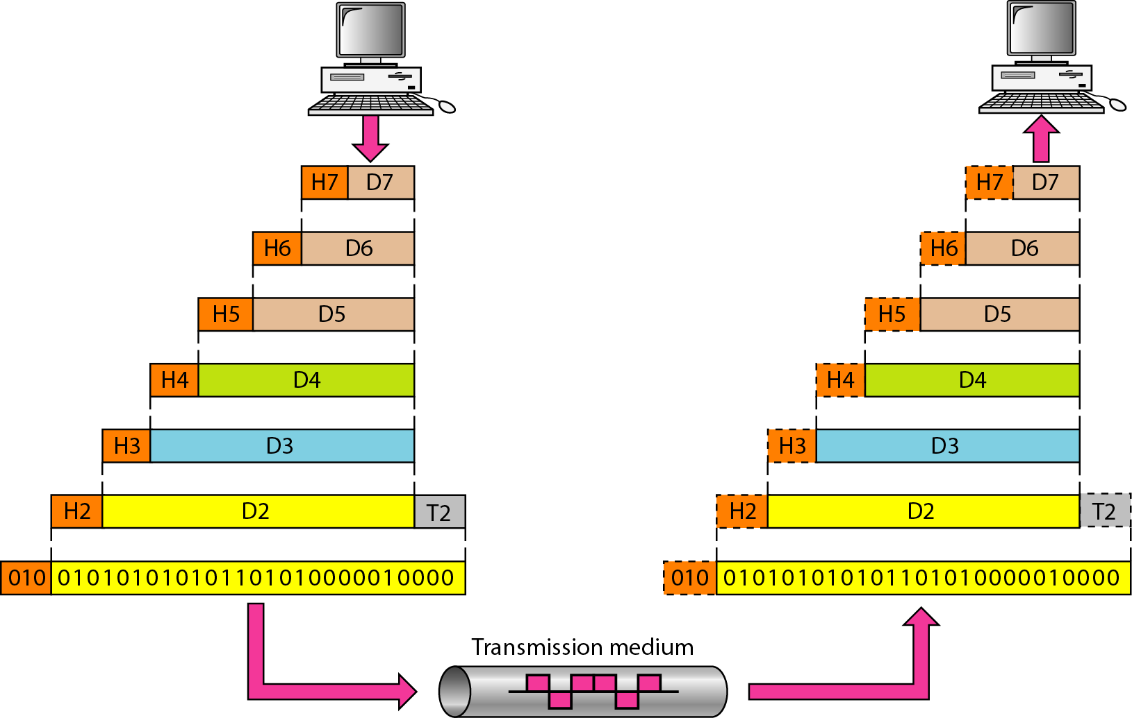
Exchange using the OSI Model

Slide 52
Physical Layer
The physical layer is responsible for movements of individual bits from one hop (node) to the next.
It is a fundamental layer underlying the higher level functions in a network. Due to large variety of available hardware technologies with widely varying characteristics, this is perhaps the most complex layer in the OSI architecture.
Physical characteristics of interface and medium:
pin assignment, connector, cables
Representation of bits: encoding
Data rate
Synchronization of bits
Line configuration: point-to-point, multipoint
Physical topology
Transmission mode: simplex, half-duplex, full-duplex

Slide 53
Physical Layer
Cabling Protocols (crossover, 100BaseT & more)
802.3 Ethernet
802.11 Wireless Used,
USB,
Bluetooth
ADSL (Asymmetric digital subscriber line)
ISDN (Integrated Services Digital Network)
SONET (Synchronous Optical NETworking)

Slide 54
Data Link Layer
The data link layer is responsible for moving frames from one hop (node) to the next.
MAIN FUCTIONS:
Framing Physical addressing Flow control Error control Access control
PROTOCOLS USED
LLC (Logical Link Control), MAC(Media Access Control), ATM, Frame Relay, Token Ring, FDDI (Fiber Distributed Data Interface) and more…

Slide 55
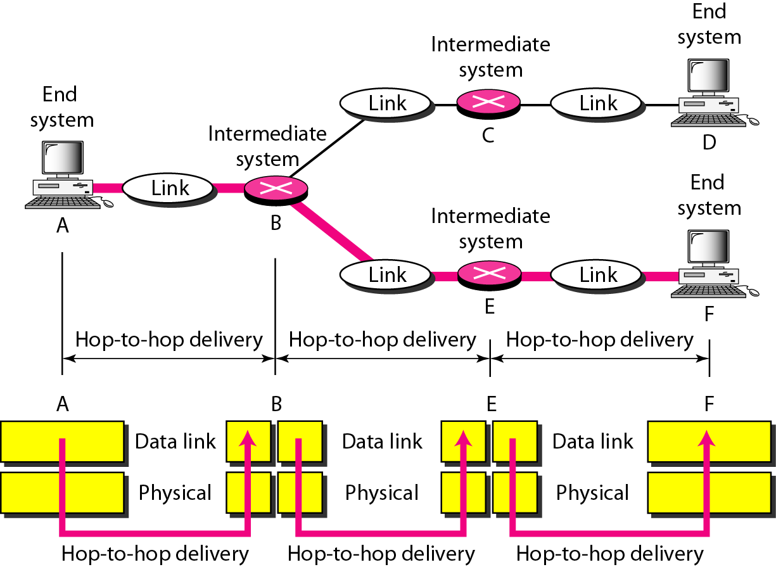
Hop-to-hop Delivery

Slide 56
Network Layer
Main function of Network Layer is to move packets from source to destination in an efficient manner (called routing), e.g., along the shortest path, and to provide internetworking of different
network types (a key service is address resolution across different networks or network layers).
PROTOCOLS USED
IPv4 IPv6 ICMP (Internet Control Message Protocol) IGMP (Internet Group Management Protocol) RIP (Routing Information Protocol) ARP (Address Resolution Protocol) RARP (Reverse Address Resolution Protocol) IPX (Internetwork Packet Exchange) BGP(Border Gateway Protocol)
MAIN FUNCTIONS
Logical addressing (IP Addressing) Routing

Slide 57
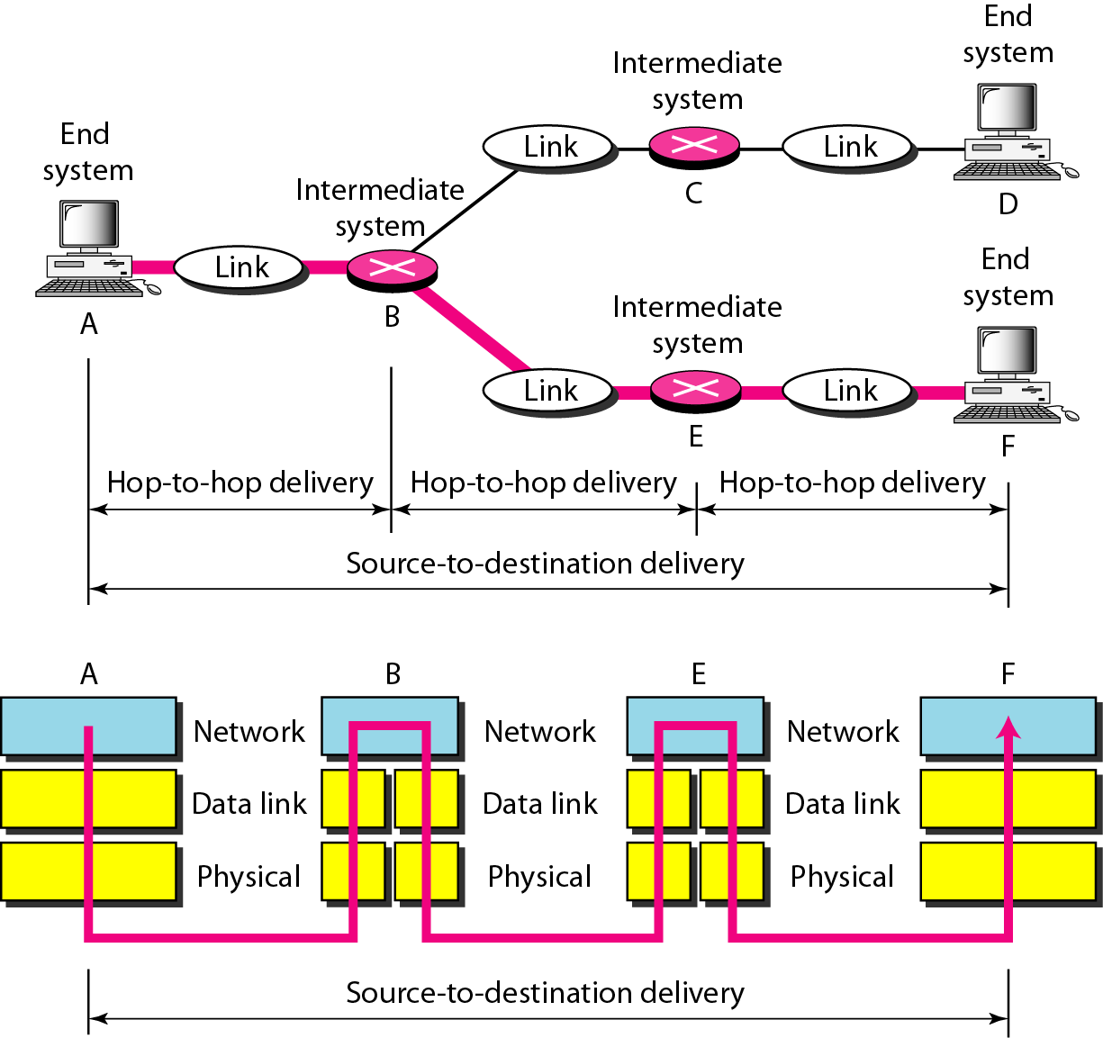
Source-to-destination delivery

Slide 58
Transport layer
The transport layer is responsible for the delivery of a message from one process to another.
Service-point addressing
Segmentation and reassembly
Connection control
Flow control
Error control
PROTOCOLS USED
TCP (Transmission Control Protocol)
UDP (User Datagram Protocol)
SCTP (Stream Control Transmission Protocol)

Slide 59
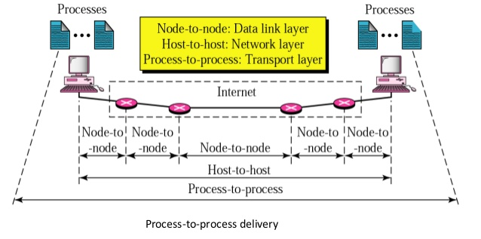
Transport layer

Slide 60
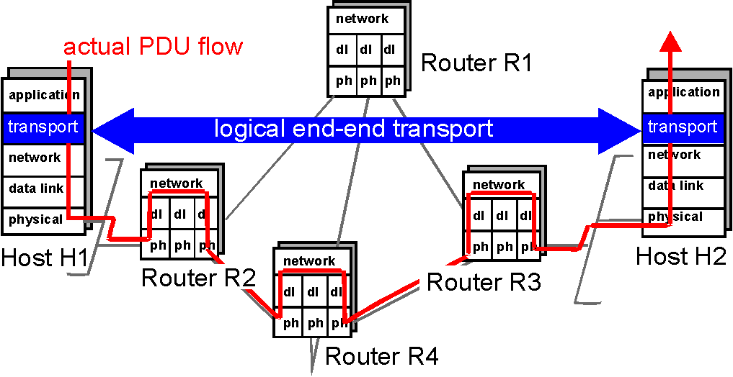
Transport layer

Slide 61
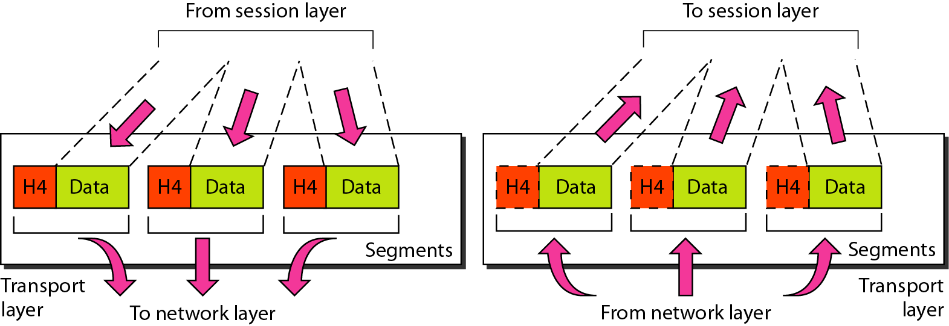
Segmentation and Reassembly
Transport layer

Slide 62
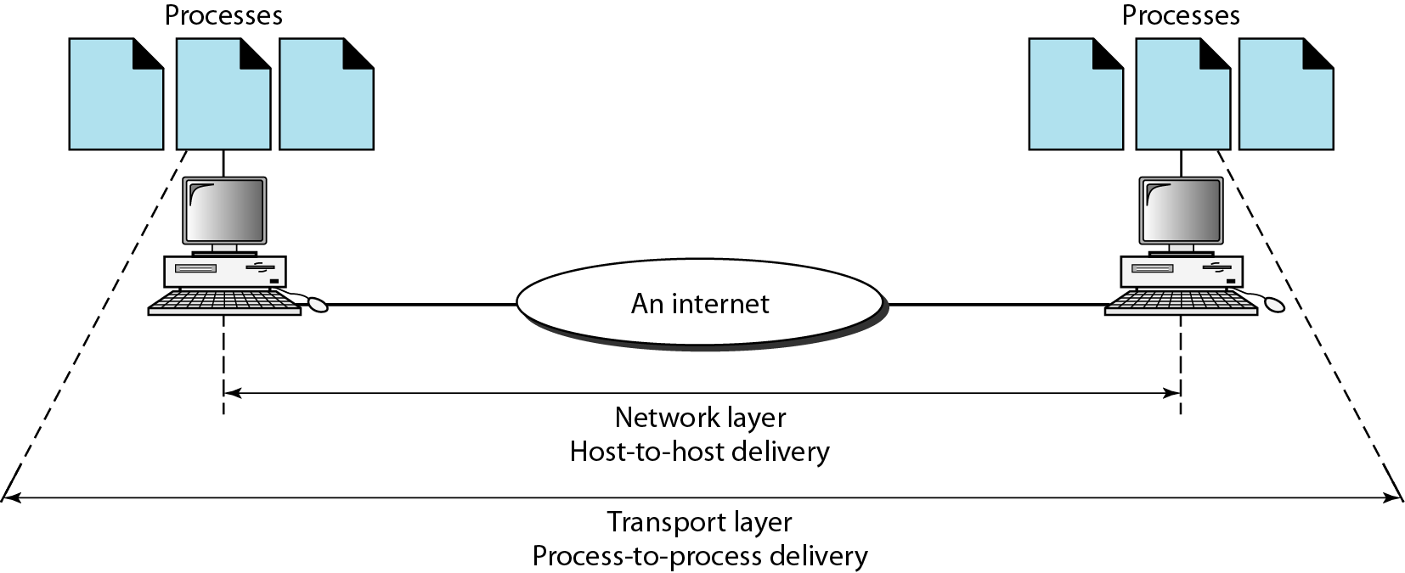
Reliable process-to-process delivery of a message

Slide 63
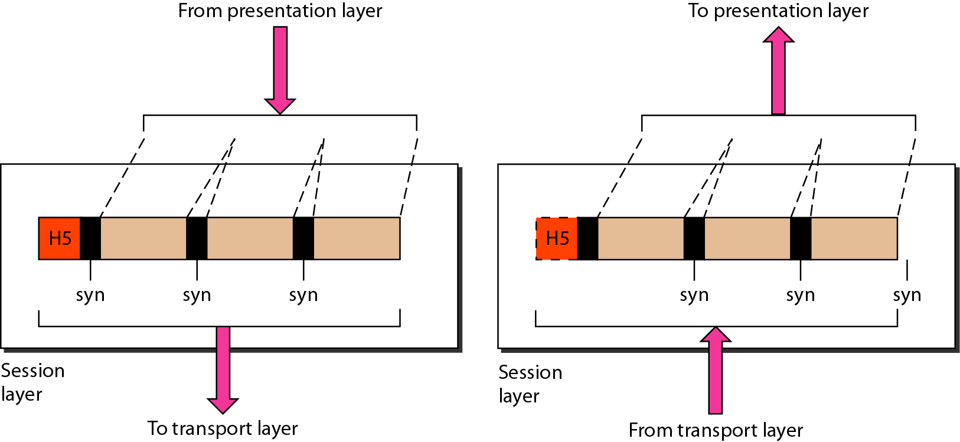
Session layer
Its function is to maintain a “conversation” across multiple related message exchanges between two hosts (called session), to keep track of the progress of their communication.
This layer establishes, authenticates, manages, and terminates sessions. Example services include keeping track of whose turn it is to transmit (dialog control) and checkpointing long conversations to allow them to resume after a crash.

Slide 64
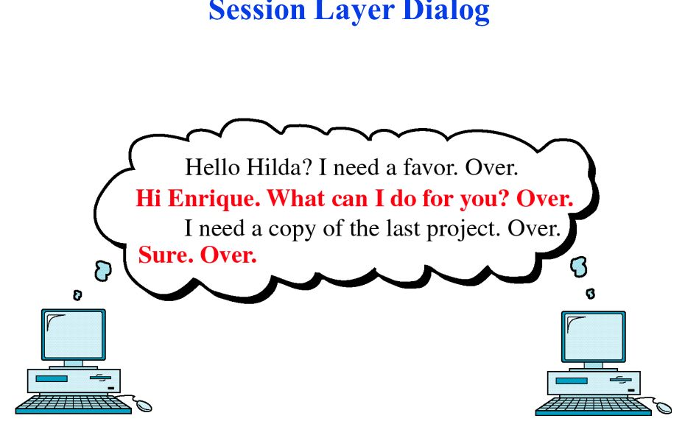
Session layer
PROTOCOLS USED:
NetBIOS, PPTP (Point-to-Point Tunneling Protocol ), NCP (NetWare Core Protocol)

Slide 65
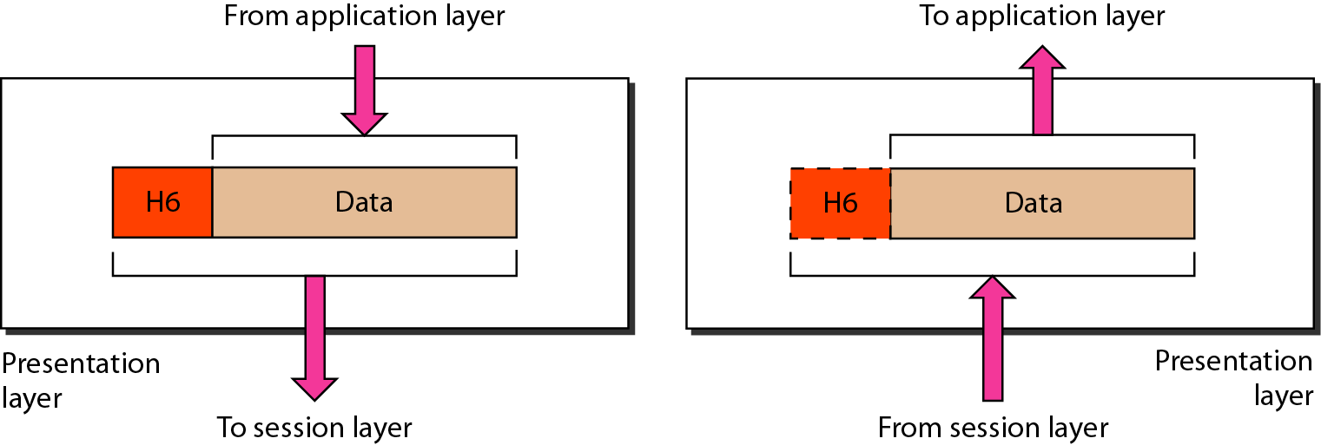
Presentation layer
The presentation layer is responsible for translation, compression, and encryption.

Slide 66
Presentation layer
PROTOCOLS USED:
ASCII (American Standard Code for Information Interchange)
EBCDIC (Extended Binary Coded Decimal Interchange Code) ,
JPEG (Joint Photographic Experts Group)
MPEG (Moving Pictures Experts Group)

Slide 67
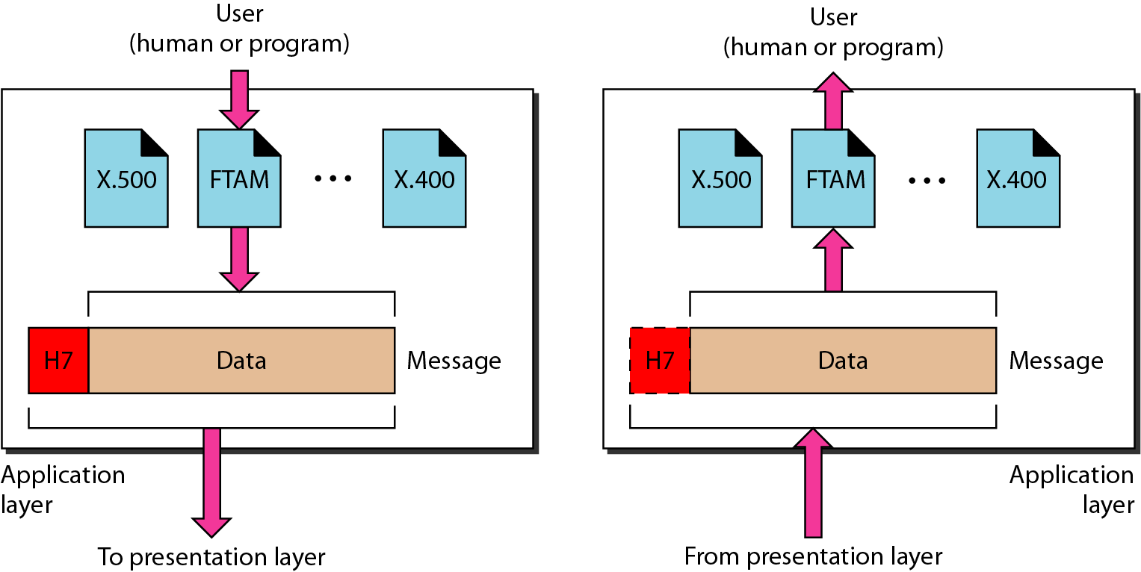
Application layer
The application layer is responsible for providing services to the user.

Slide 68
Application layer
PROTOCOLS USED:
Telnet (Remote login to hosts)
DNS (Domain Name System)
DHCP (Dynamic Host Configuration Protocol )
FTP (File Transfer Protocol)
HTTP (Hypertext Transfer Protocol)
SMTP (Simple Mail Transfer Protocol )
SNTP (Simple Network Time Protocol)

Slide 69
Crossover | A crossover cable, occasionally called crossed cable, connects two Ethernet network devices to each other. They were created to support temporary host-to-host networking in situations where an intermediate device like a network router is not present.
100BASE-T | 100BASE-T is an enhanced form of Ethernet 10BASE-T and a network standard used for fast data transfer rates up to 100 Mbps
Ethernet | Ethernet, is the standard way to connect computers on a network over a wired connection. It provides a simple interface and for connecting multiple devices, such computers, routers, and switches.
ATM | Asynchronous transfer mode (ATM) is a switching technique used by telecommunication networks that uses asynchronous time-division multiplexing to encode data into small, fixed-sized cells.
Frame relay | Frame relay is a data link layer, digital packet switching network protocol technology designed to connect Local Area Networks (LANs) and transfer data across Wide Area Networks (WANs).
NetBIOS | NetBIOS (Network Basic Input/Output System) is a program that allows applications on different computers to communicate within a local area network (LAN).
PPTP | The Point-to-Point Tunneling Protocol (PPTP) is a method for implementing virtual private networks, with many known security issues.

Slide 70
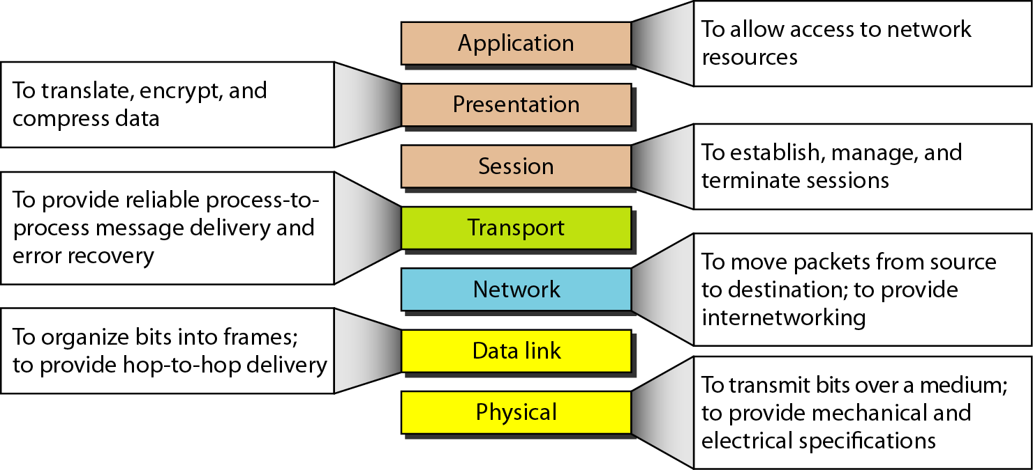
Summary of layers

Slide 71
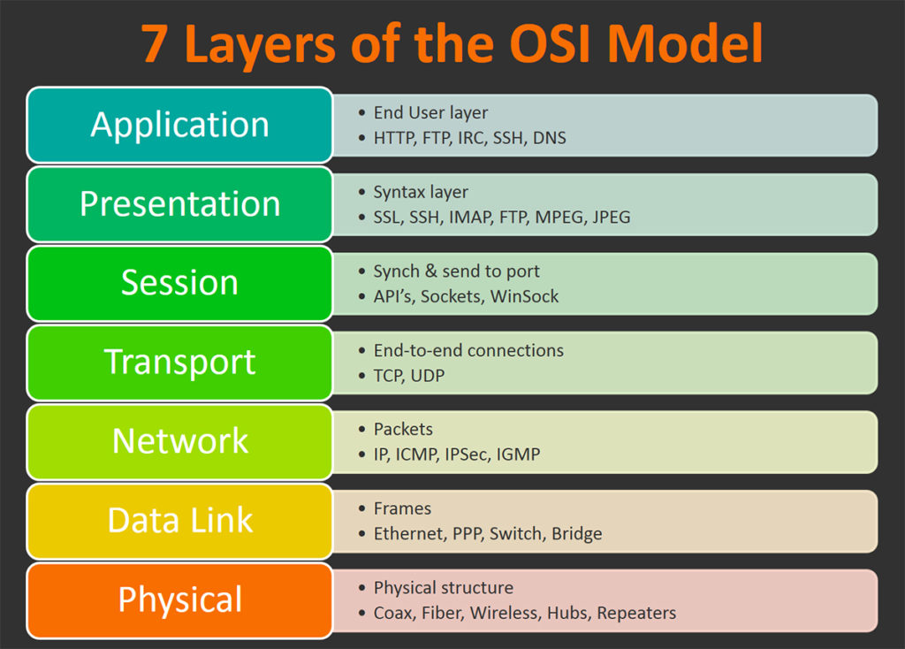
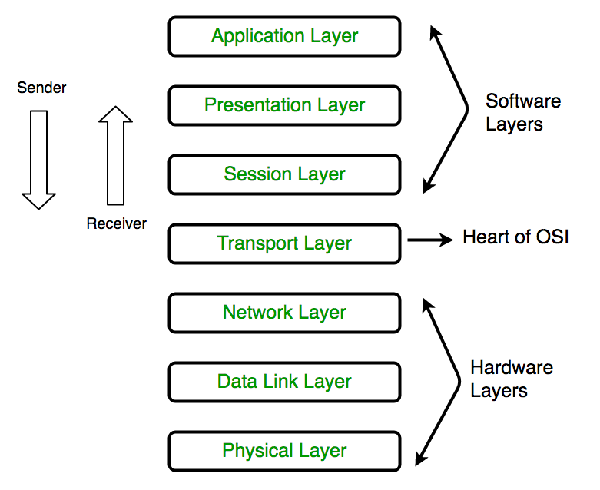

Slide 72
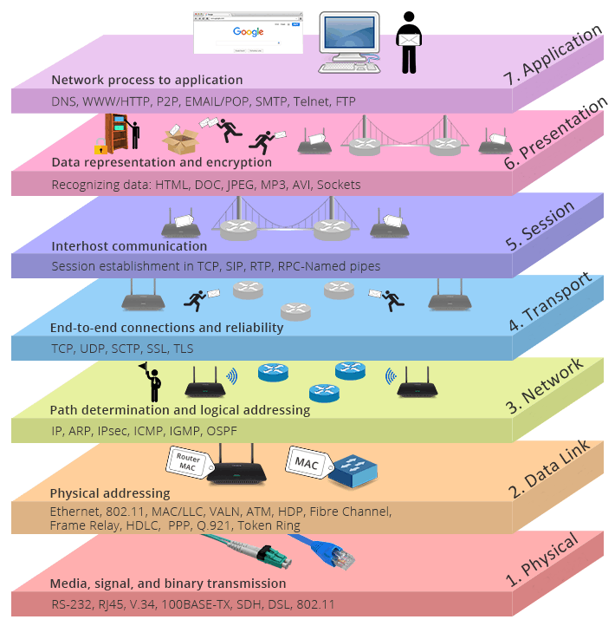

Slide 73
TCP/IP PROTOCOL SUITE
The layers in the TCP/IP protocol suite do not exactly match those in the OSI model. The original TCP/IP protocol suite was defined as having four layers: host-to-network, internet, transport, and application.
However, when TCP/IP is compared to OSI, we can say that the TCP/IP protocol suite is made of five layers:
physical
data link
Internet
transport
application.

Slide 74
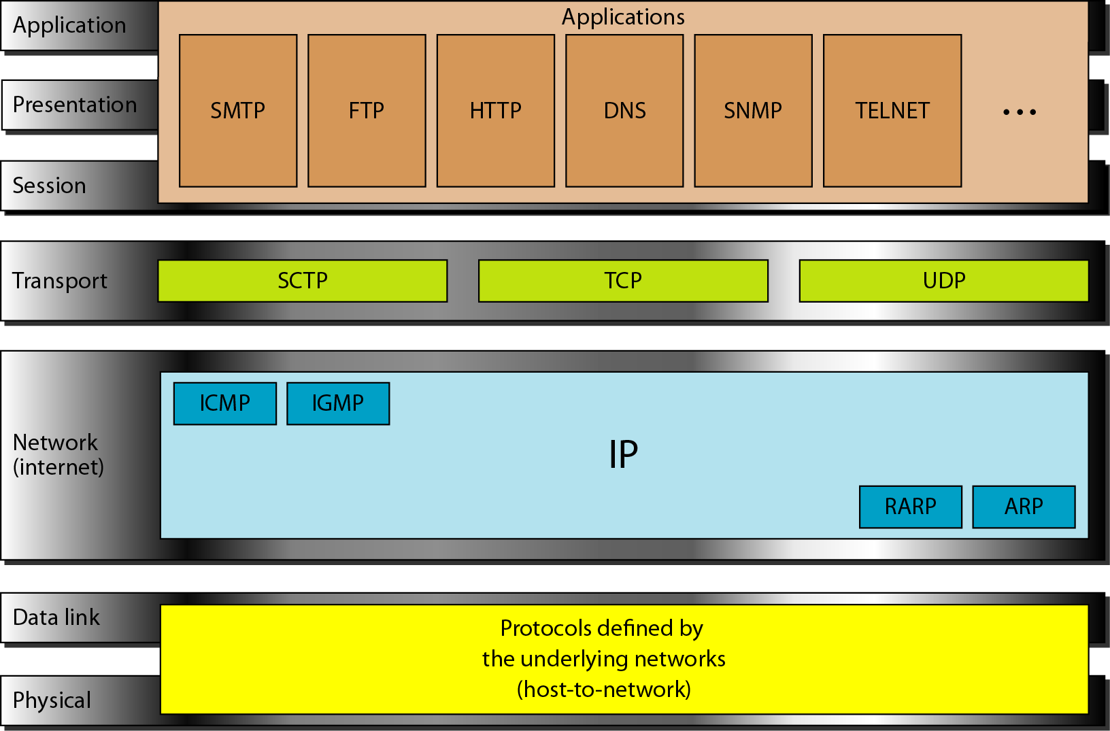
TCP/IP and OSI model

Slide 75
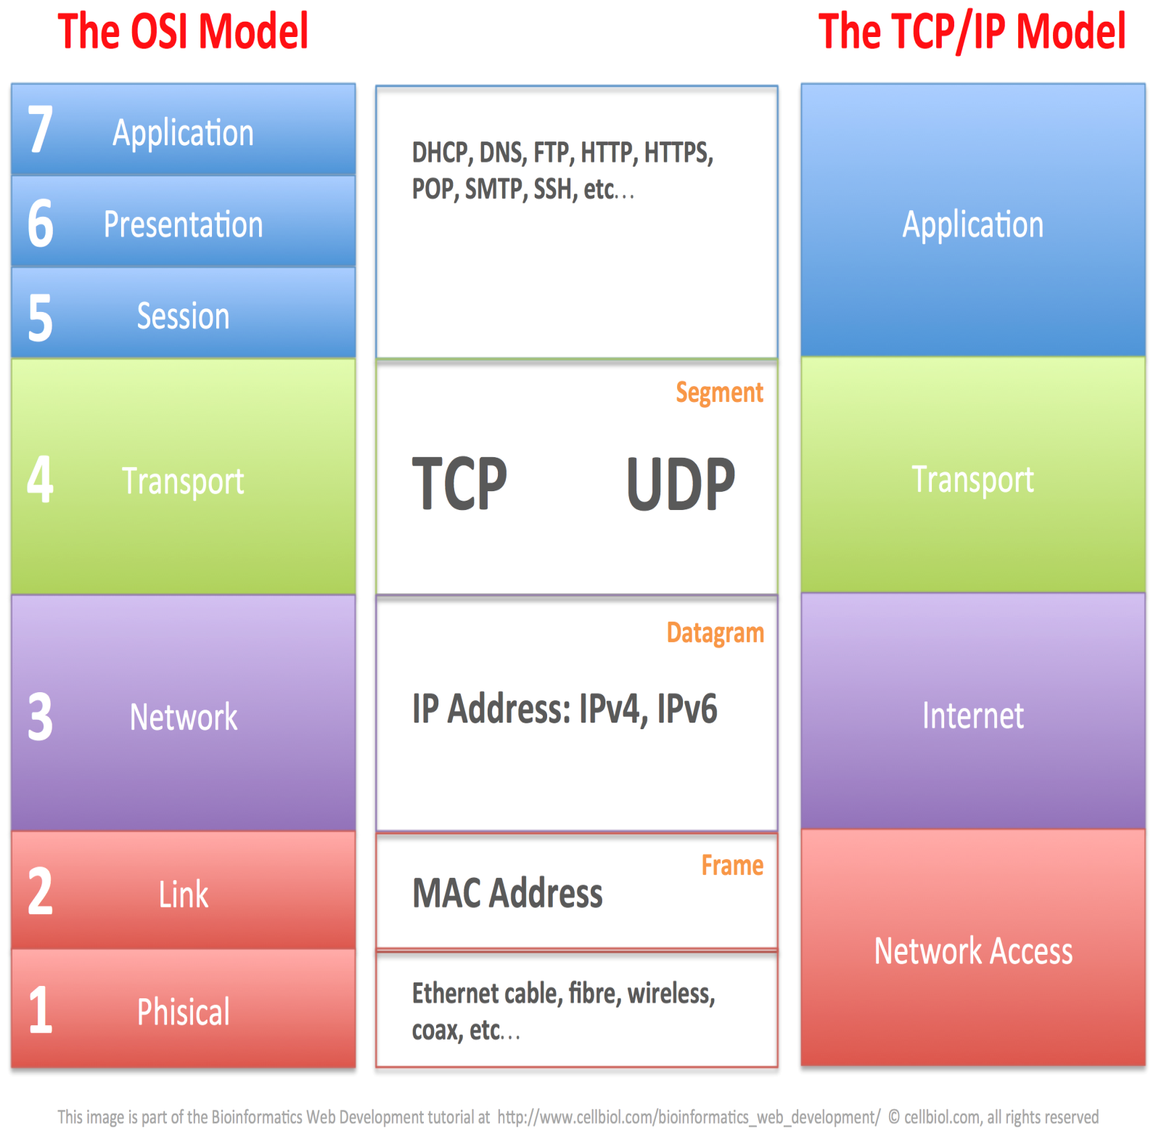

Slide 76
Network Interface Layer/Network Access(Host to Network)
The Network Interface layer (also called the Network Access layer) sends TCP/IP packets on the network medium and receives TCP/IP packets off the network medium.
TCP/IP was designed to be independent of the network access method, frame format, and medium.
Therefore, you can use TCP/IP to communicate across differing network types that use LAN technologies—such as Ethernet and 802.11 wireless LAN—and WAN technologies—such as Frame Relay and Asynchronous Transfer Mode (ATM).
By being independent of any specific network technology, TCP/IP can be adapted to new technologies.

Slide 77
Internet Layer
The Internet layer responsibilities include addressing, packaging, and routing functions. The Internet layer is analogous to the Network layer of the OSI model.
The core protocols for the TCP/IP Internet layer consist of the following:
Address Resolution Protocol (ARP) -resolves the Internet layer address to a Network Interface layer address such as a hardware address.
The Internet Protocol (IP) -is a routable protocol that addresses, routes, fragments, and reassembles packets.IPv4,IPv6.
The Internet Control Message Protocol (ICMP) reports errors and other information to help you diagnose unsuccessful packet delivery.
The Internet Group Management Protocol (IGMP) manages IP multicast groups.

Slide 78
Transport Layer
The Transport layer (also known as the Host-to-Host Transport layer) is responsible for providing the Application layer with session and datagram (header+payload) communication services. The core protocols of the Transport layer are Transmission Control Protocol (TCP) and the User Datagram Protocol (UDP).
TCP
one-to-one
connection-oriented
reliable communications service
the sequencing and acknowledgment of packets sent.
recovery of packets lost during transmission.
UDP
one-to-one or one-to-many
connectionless
unreliable communications service.
UDP is used when the amount of data to be transferred is small (such as the data that would fit into a single packet
when the overhead of establishing a TCP connection is not desired or when the applications or upper layer protocols provide reliable delivery.
The Transport layer encompasses the responsibilities of the OSI Transport layer and some of the responsibilities of the OSI Session layer.

Slide 79
Application Layer
The Application layer provides applications the ability to access the services of the other layers and defines the protocols that applications use to exchange data. There are many Application layer protocols and new protocols are always being developed.
The most widely-known Application layer protocols are those used for the exchange of user information:
The Hypertext Transfer Protocol (HTTP) is used to transfer files that make up the Web pages of the World Wide Web.
The File Transfer Protocol (FTP) is used for interactive file transfer.
The Simple Mail Transfer Protocol (SMTP) is used for the transfer of mail messages and attachments.
Telnet, a terminal emulation protocol, is used for logging on remotely to network hosts.
Additionally, the following Application layer protocols help facilitate the use and management of TCP/IP networks:
The Domain Name System (DNS) is used to resolve a host name to an IP address.
The Routing Information Protocol (RIP) is a routing protocol that routers use to exchange routing information on an IP internetwork.
The Simple Network Management Protocol (SNMP) is used between a network management console and network devices (routers, bridges, intelligent hubs) to collect and exchange network management information.
Examples of Application layer interfaces for TCP/IP applications are Windows Sockets and NetBIOS

Slide 80
Physical Address, Logical Address and Port Address
Physical address(MAC : Media Access Control): Each system having a NIC(Network Interface Card). This is specified by the manufacture company of the card. This address is used by data link layer.
07:01:02:01:2C:4B, A 6-byte (12 hexadecimal digits) physical address
Logical Address: An IP address of the system is called logical address. This address is the combination of Net ID and Host ID. This address can be changed by changing the host position on the network. So it is called logical address. Used in Network layer.
An IP address (IPv4) consists of four decimal numbers separated by period.130.57.64.11
Port Address: There are many application running on the computer. Each application run with a port no.(logically) on the computer. This port no. for application is decided by the Kernel of the OS. This port no. is called port address.
753, 8080 etc.: 16-bit port address represented as one number
Socket Address: Process to process delivery (transport layer communication) needs two identifiers, one is IP address and the other is port number at each end to make a connection.
Socket address is the combinations of IP address and port number as shown:
192.168.10.4 (IP):8080 (Port Number)

Slide 81
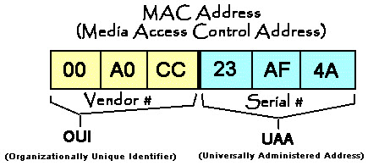
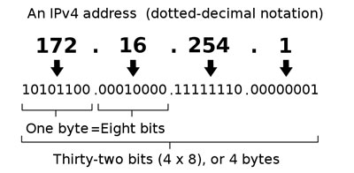




128 -Bit scheme (16 byte),
each field 16-bit
8-bit (1-byte) each field

Slide 82
Comparison Between OSI and TCP/IP

Slide 83
Comparison Between OSI and TCP/IP-contd.

Slide 84
OSI(Open System Interconnection) | TCP/IP(Transmission Control Protocol / Internet Protocol)
1. OSI is a generic, protocol independent standard, acting as a communication gateway between the network and end user. | 1. TCP/IP model is based on standard protocols around which the Internet has developed. It is a communication protocol, which allows connection of hosts over a network.
2. In OSI model the transport layer guarantees the delivery of packets. | 2. In TCP/IP model the transport layer does not guarantees delivery of packets. Still the TCP/IP model is more reliable.
3. Follows vertical approach. | 3. Follows horizontal approach.
4. OSI model has a separate Presentation layer and Session layer. | 4. TCP/IP does not have a separate Presentation layer or Session layer.
5. Transport Layer is Connection Oriented. | 5. Transport Layer is both Connection Oriented and Connection less.
6. Network Layer is both Connection Oriented and Connection less. | 6. Network Layer is Connection less.
7. OSI is a reference model around which the networks are built. Generally it is used as a guidance tool. | 7. TCP/IP model is, in a way implementation of the OSI model.
8. OSI model has a problem of fitting the protocols into the model. | 8. TCP/IP model does not fit any protocol
9. Protocols are hidden in OSI model and are easily replaced as the technology changes. | 9. In TCP/IP replacing protocol is not easy.
10. OSI model defines services, interfaces and protocols very clearly and makes clear distinction between them. It is protocol independent. | 10. In TCP/IP, services, interfaces and protocols are not clearly separated. It is also protocol dependent.
11. It has 7 layers | 11. It has 4 layers

Slide 85

Network Topology
The network topology defines the way in which computers, printers, and other devices are connected.
A network topology describes the layout of the wire and devices as well as the paths used by data transmissions.
Types-
Basic Topologies:
Bus
Ring
Star
Mesh
Derived Topologies
Tree
Hybrid

Slide 86

Bus topology
No. of Links: 1 cable (backbone) and n droplines (links)
No.of I/O Ports: 1 (1 neighbour)
Advantages of Bus Topology
Works well for small networks
Relatively inexpensive to implement
Easy to add to it
Disadvantages of Bus Topology
Management costs can be high
Potential for congestion with network traffic

Slide 87

Ring Topology
No. of Links: n
No.of I/O Ports: 2 (2 neighbours)
Advantages of Ring Topology
Easier to manage; easier to locate a defective node or cable problem
Well-suited for transmitting signals over long distances on a LAN
Handles high-volume network traffic
Enables reliable communication
Disadvantages of Ring Topology
Expensive
Requires more cable and network equipment at the start
Not used as widely as bus topology
Fewer equipment options
Fewer options for expansion to high-speed communication

Slide 88

Star Topology
No. of Links: n
No. of I/O Ports: 1 (1 neighbour i.e only hub)
Advantages of Star Topology
Good option for modern networks
Low startup costs
Easy to manage
Offers opportunities for expansion
Most popular topology in use; wide variety of equipment available
Disadvantages of Star Topology
Hub is a single point of failure
Requires more cable than the bus

Slide 89

Mesh Topology
No. of Links: n(n-1) simplex links, n(n-1)/2 duplex*
No. of I/O Ports: n-1 (n-1 neighbours)
A mesh network is a network topology in which each node relays data for the network. All mesh nodes cooperate in the distribution of data in the network.
Mesh networks can relay messages using either a flooding technique or a routing technique.
Advantages
Less Traffic
Reliability
Ever growing
Disadvantages
Highly expensive
High maintenance
*=duplex required single wire for both ways communication ,
so it is equal to total number of edges
But simplex will require two wires for both ways communication,
one for each direction ,so it will require the double of duplex.

Slide 90
For ‘n’ devices in a network, the number of cable links required for a mesh, ring, bus, and star topology:
Mesh: n * (n-1) / 2
Ring: n
Bus: n + 1 (n for cables, 1 for backbone)
Star: n

Slide 91
Question: Assume six devices are arranged in a mesh topology. How many cables are needed? How many ports are needed for each device?
Solution: Cables needed=n * (n-1)/2 = 6 * 5 / 2 = 15 cables.
Number of devices connected per device = n-1 = 5, so number of ports per device = 5.

Slide 92

Derived Topology-Tree Topology
A Tree topology is a combination of two or more star topology connected together by central bus backbone or star backbone.
The tree topology is ideal when the workstations are located in groups, with each group occupying a relatively small physical region.
Advantages and Disadvantages
Same as Star and Bus topology

Slide 93

Derived Topology-Hybrid Topology
A hybrid topology is a type of network topology that uses two or more other network topologies, including bus topology, mesh topology, ring topology, star topology, and tree topology.
Advantages of Hybrid Network Topology
1) Reliable : Unlike other networks, fault detection and troubleshooting is easy in this type of topology.
2) Scalable: Its easy to increase the size of network by adding new components, without disturbing existing architecture. 3) Flexible: Hybrid Network can be designed according to the requirements of the organization and by optimizing the available resources. 4) Effective: Hybrid topology is the combination of two or more topologies, so we can design it in such a way that strengths of constituent topologies are maximized while there weaknesses are neutralized.
Disadvantages of Hybrid Topology
1) Complexity of Design: One of the biggest drawback of hybrid topology is its design. Its not easy to design this type of architecture and its a tough job for designers. Configuration and installation process needs to be very efficient. 2) Costly Hub: The hubs used to connect two distinct networks, are very expensive. These hubs are different from usual hubs as they need to be intelligent enough to work with different architectures and should be function even if a part of network is down. 3) Costly Infrastructure: As hybrid architectures are usually larger in scale, they require a lot of cables, cooling systems, sophisticate network devices, etc.

Slide 94
Backbone Networks
A backbone is a part of computer network that interconnects various pieces of network, providing a path for the exchange of information between different LANs and subnetworks.
A backbone can tie together diverse networks in the same building, in different buildings in a campus environment, or over wide areas. Normally, the backbone's capacity is greater than the networks connected to it.

Slide 95
BACKBONE NETWORKS
A backbone network allows several LANs to be connected. In a backbone network, no station is directly connected to the backbone; the stations are part of a LAN, and the backbone connects the LANs.
Examples:
Bus Backbone Star Backbone

Slide 96


In a bus backbone, the topology of the backbone is a bus.
In a star backbone, the topology of the backbone is a star;
the backbone is just one switch.

Slide 97

Backbone Networks: Serial Backbone
Daisy chain: linked series of devices
Hubs and switches often connected in daisy chain to extend a network
Hubs, gateways, routers, switches, and bridges can form part of backbone

Slide 98

Backbone Networks: Distributed Backbone
A distributed backbone is a backbone network that consists of a number of connectivity devices connected to a series of central connectivity devices, such as hubs, switches, or routers, in a hierarchy.

Slide 99

Backbone Networks: Collapsed Backbone
A network configuration that provides a backbone in a centralized location, to which all subnetworks are attached. A collapsed backbone is implemented in a router or switch that uses a high-speed backplane that can handle the simultaneous traffic of all or most of its ports at full wire speed.

Slide 100

Backbone Networks: Parallel Backbone
When organizations are looking for a very strong and trustworthy backbone they should choose a parallel backbone. This backbone is a variation of a collapsed backbone in that it uses a central node (connection point).

Slide 101

Hybrid Model-The Internet Model

Slide 102
The Internet today
The Internet today is an internetwork that allows any user to become part of it. The user, however, needs to be physically connected to an ISP. The physical connection is normally done through a point-to-point WAN.
1.102

Slide 103

Connecting Devices

Slide 104

Connecting Devices
Those which operate at the physical layer (a repeater or an active hub).
Those which operate at the physical and data link layers (a bridge or a two-layer switch)
Those which operate at the physical, data link, and network layers (a router or a three-layer switch).
Those which can operate at all five/seven layers (a gateway).

Slide 105


Repeater/Amplifier-Layer 1 Device
A repeater is a device that operates only in the physical layer.
Signals that carry information within a network can travel a fixed distance before attenuation endangers the integrity of the data. A repeater receives a signal and, before it becomes too weak or corrupted, regenerates the original bit pattern. The repeater then sends the refreshed signal.
A repeater forwards every frame; it has no filtering capability.
A repeater is a regenerator, not an amplifier.

Slide 106

REPEATER
A repeater operates at the physical layer. Its job is to regenerate the signal over the same network before the signal becomes too weak or corrupted so as to extend the length to which the signal can be transmitted over the same network.
An important point to be noted about repeaters is that they do no amplify the signal. When the signal becomes weak, they copy the signal bit by bit and regenerate it at the original strength. It is a 2 port device.

Slide 107

HUB
A hub is basically a multiport repeater. A hub connects multiple wires coming from different branches. For example, the connector in star topology which connects different stations. Hubs cannot filter data, so data packets are sent to all connected devices.
Also, they do not have intelligence to find out best path for data packets which leads to inefficiencies and wastage.
Passive hub(Connector)-Below Layer 1.
Merely connects cables on a network and provides no signal regeneration
Active hubs(Repeater/Amplifier)-Layer 1 Device
Amplify or repeat signals that pass through them
Advantages
1.Can extend a network’s total distance
2.Do not seriously affect network performance
3.Certain repeaters can connect networks using different physical media
Disadvantages
1.Cannot connect different network architectures, such as Token Ring and Ethernet
2.Do not reduce network traffic
3.They repeat everything they receive
4.Do not segment the network
5.Do not reformat data structures
6.Cannot connect networks that require different types of frames

Slide 108

BRIDGES-Layer 2 Device
A bridge operates in both the physical and the data link layer.
As a physical layer device, it regenerates the signal it receives. (A repeater).
As a data link layer device, the bridge can check the physical (MAC) addresses (source and destination) contained in the frame. A bridge connects different segments of the same LAN.
A bridge has filtering capability. It can check the destination address of a frame and decide if the frame should be forwarded or dropped.
If the frame is to be forwarded, the decision must specify the port. A bridge has a table that maps addresses to ports.
A bridge has a table used in filtering decisions.

Slide 109

BRIDGES
A bridge connecting two LANs
A bridge does not change the physical (MAC) addresses in a frame.

Slide 110

NETWORK BRIDGE
A network bridge is a product that connects a local area network (LAN) to another local area network that uses the same protocol.
Bridges are similar to—but more intelligent than—simple repeaters, which also extend signal range. It has a single input and single output port, thus making it a 2 port device.

Slide 111

SWITCH
A switch is a multi port bridge with a buffer and a design that can boost its efficiency(large number of ports imply less traffic) and performance.
Switch is a data link layer device. Switch can perform error checking before forwarding data, that makes it very efficient as it does not forward packets that have errors and forward good packets selectively to correct port only. In other words, switch divides collision domain of hosts, but broadcast domain remains same.
A Switch operates in both the physical and the data link layer.
Increase network performance by reducing the number of frames transmitted to the rest of the network. Switch opens a virtual circuit between the source and the destination.
When two machines have a virtual circuit. They do not have to share the bandwidth with any other computers
Multiple virtual circuits can be in use at the same time, each with its own full bandwidth Called “switched bandwidth”

Slide 112


ROUTERS-LAYER 3 DEVICE
A router is a three-layer device that routes packets based on their logical addresses (host-to-host addressing).
A router normally connects LANs and WANs in the Internet and has a routing table that is used for making decisions about the route.
The routing tables are normally dynamic and are updated using routing protocols

Slide 113

A Router in the OSI Model

Slide 114

ROUTERS
A router is a device like a switch that routes data packets based on their IP addresses. Router is mainly a Network Layer device.
Routers normally connect LANs and WANs together and have a dynamically updating routing table based on which they make decisions on routing the data packets. Router divide broadcast domains of hosts connected through it.

Slide 115

GATEWAY-LAYER 5/7 DEVICE
A gateway is normally a router that operates in all five layers of the Internet or seven layers of OSI model.
A gateway takes an application message, reads it, and interprets it. This means that it can be used as a connecting device between two internetworks that use different models.
Gateways can provide security.

Slide 116

A Gateway in the OSI Model

Slide 117

NETWORK GATEWAY
A gateway, as the name suggests, is a passage to connect two networks together that may work upon different networking models.
They basically works as the messenger agents that take data from one system, interpret it, and transfer it to another system. Gateways are also called protocol converters and can operate at any network layer. Gateways are generally more complex than switch or router. A gateway can be implemented completely in software, hardware, or in a combination of both.

Slide 118
Data and Signals

Slide 119
3-1 ANALOG AND DIGITAL
Data can be analog or digital. The term analog data refers to information that is continuous; digital data refers to information that has discrete states. Analog data take on continuous values. Digital data take on discrete values.
Signals can be analog or digital.
Analog signals can have an infinite number of values in a range.
Digital signals can have only a limited number of values.

Slide 120

In data communications, we commonly use periodic analog signals and nonperiodic digital signals.

Slide 121

Figure 3.4 Two signals with the same amplitude and phase, but different frequencies

Slide 122
Example 3.3
The power we use at home has a frequency of 60 Hz. The period of this sine wave can be determined as follows:

Slide 123
Example 3.5
The period of a signal is 100 ms. What is its frequency in kilohertz?
Solution
First we change 100 ms to seconds, and then we calculate the frequency from the period (1 Hz = 10⁻³ kHz).

Slide 124

Note
If a signal does not change at all, its frequency is zero.
If a signal changes instantaneously, its frequency is infinite.

Slide 125
Note
Phase describes the position of the waveform relative to time 0.

Slide 126

Figure 3.5 Three sine waves with the same amplitude and frequency, but different phases

Slide 127
Example 3.6
A sine wave is offset 1/6 cycle with respect to time 0. What is its phase in degrees and radians?
Solution
We know that 1 complete cycle is 360°. Therefore, 1/6 cycle is

Slide 128

Figure 3.7 The time-domain and frequency-domain plots of a sine wave

Slide 129
Note
A complete sine wave in the time domain can be represented by one single spike in the frequency domain.

Slide 130

Figure 3.12 The bandwidth of periodic and nonperiodic composite signals
Bandwidth=f_{high}-f_{low}

Slide 131
Example 3.12
A nonperiodic composite signal has a bandwidth of 200 kHz, with a middle frequency of 140 kHz and peak amplitude of 20 V. The two extreme frequencies have an amplitude of 0. Draw the frequency domain of the signal.
Solution
The lowest frequency must be at 40 kHz and the highest at 240 kHz. Figure 3.15 shows the frequency domain and the bandwidth.

Slide 132

Figure 3.15 The bandwidth for Example 3.12

Slide 133
Physical Layer
The physical layer is concerned with transmission of raw bits over a communication channel.
It specifies the mechanical, electrical and procedural network interface specifications and the physical transmission of bit streams over a transmission medium connecting two pieces of communication equipment.
In simple terms, the physical layer decides the following (design issues):
Number of pins and functions of each pin of the network connector (Mechanical)
Signal Level, Data rate (Electrical)
Whether simultaneous transmission in both directions
Establishing and breaking of connection
Deals with physical transmission
There exist a variety of physical layer protocols such as RS-232C, Rs-449 standards developed by Electronics Industries Association (EIA).

Slide 134
DIGITAL SIGNALS
In addition to being represented by an analog signal, information can also be represented by a digital signal.
For example, a 1 can be encoded as a positive voltage and a 0 as zero voltage.
A digital signal can have more than two levels.
In this case, we can send more than 1 bit for each level.
Topics discussed in this section:
Bit Rate
Baud rate Bit Length

Slide 135
Bit Rate and Baud Rate
Bit rate is simply the number of bits (i.e., 0’s and 1’s) transmitted in per unit time. It determines the number of bits traveled per second.
Bit rate = baud rate x the number of bits per signal unit
Kbps Vs KBps???
Baud rate (Signal rate) is the number of signal units transmitted per unit time that is needed to represent those bits. i.e. How many times signal changes per unit time?
Baud rate = bit rate / the number of bits per signal unit

Slide 136

Bit Rate and Baud Rate

Slide 137


Bit Rate and Baud Rate
Baud rate is calculated using the below formula. S= C*N /r baud
here, C is case factor given (if not then C=1), N is the bit rate and r is the number of data elements carried by each signal element i.e. r=data element/signal element.
Here r must be as great as possible for better efficiency.
For 4 bits data transmitted
←4 times signal change
Only 2 times signal change→
Here, the data rate(bitrate) and signal rate(baud) are same and r is one. One data element rides on one signal element (analogous to one person per carriage in a train).
There are two data elements transmitted per signal element. In other words, the bit rate is higher than the baud rate. (Analogous to two passengers per carriage in a train) and here r is two. Hence baud rate is one half of bit rate.

Slide 139
Example 3.16
If a signal has ‘L’ levels, then we need log₂L number of bits to represent the data.
A digital signal has eight levels. How many bits are needed per level? We calculate the number of bits from the formula
Each signal level is represented by 3 bits.
A digital signal has nine levels. How many bits are needed per level?
3.17 bits but it is not a power of 2 ,
hence 4 bits.

Slide 140

Figure : Two digital signals: one with two signal levels and the other with four signal levels
Signal Level =2
Data element=1
Signal element=1
r=1/1=1
Baud rate= 8/r=8 bauds
Signal Level =4
Data element=2
Signal element=1
r=2/1=2
Baud rate= 16/r=8 bauds

Slide 141
Ques. A signal is carrying data in which one data element is encoded as one signal element and bit rate of 100 kbps. What is the average value of baud rate if c is between 0 and 1.
Signal Rate = case factor * Bit Rate * 1/r
i.e S or B_{min}= c * N * 1/r
If case factor is not given, assume it is 1.

Slide 143

TRANSMISSION IMPAIRMENT
Signals travel through transmission media, which are not perfect. The imperfection causes signal impairment. This means that the signal at the beginning of the medium is not the same as the signal at the end of the medium. What is sent is not what is received. Three causes of impairment are attenuation, distortion, and noise.

Slide 144
Attenuation
Means loss of energy -> weaker signal
When a signal travels through a medium it loses energy overcoming the resistance of the medium
Amplifiers are used to compensate for this loss of energy by amplifying the signal.
To show the loss or gain of energy the unit “decibel” is used.
dB = 10 log₁₀ P₂/P₁
P₁ - input signal
P₂ - output signal

Slide 145

Attenuation

Slide 146

Example
Suppose a signal travels through a transmission medium and its power is reduced to one-half. This means that P2 is P1 / 2. In this case, the attenuation (loss of power) can be calculated as
A loss of 3 dB (–3 dB) is equivalent to losing one-half the power.

Slide 147

Example
The loss in a cable is usually defined in decibels per kilometer (dB/km). If the signal at the beginning of a cable with −0.3 dB/km has a power of 2 mW, what is the power of the signal at 5 km?
Solution
The loss in 5 km cable in decibels is 5 × (−0.3) = −1.5 dB.
P₁=2mW
We can calculate the power as -

Slide 148
Distortion
Means that the signal changes its form or shape
Distortion occurs in composite signals
Each frequency component has its own propagation speed traveling through a medium.
The different components therefore arrive with different delays at the receiver.
That means that the signals have different phases at the receiver than they did at the source.

Slide 149

Distortion

Slide 150
Noise
There are different types of noise
Thermal - random noise of electrons in the wire creates an extra signal
Induced - from motors and appliances, devices act are transmitter antenna and medium as receiving antenna.
Crosstalk - same as above but between two wires.
Impulse - Spikes that result from power lines, lightning, etc.

Slide 151

Noise

Slide 152
DATA RATE LIMITS
A very important consideration in data communications is how fast we can send data, in bits per second, over a channel. Data rate depends on three factors:
1. The bandwidth available
2. The level of the signals we use
3. The quality of the channel (the level of noise)
Noiseless Channel: Nyquist Bit Rate
Noisy Channel: Shannon Capacity
Using Both Limits
Increasing the levels of a signal increases the probability of an error occurring, in other words it reduces the reliability of the system. Why??

Slide 153
Capacity of a System
The bit rate of a system increases with an increase in the number of signal levels we use to denote a symbol.
A symbol can consist of a single bit or “n” bits.
The number of signal levels = 2^{n}.
As the number of levels goes up, the spacing between level decreases -> increasing the probability of an error occurring in the presence of transmission impairments.

Slide 154
Nyquist Theorem
Nyquist gives the upper bound for the bit rate of a transmission system by calculating the bit rate directly from the number of bits in a symbol (or signal levels) and the bandwidth of the system.
Nyquist theorem states that for a noiseless channel:
C = 2*B*log₂ L,
Where, L =no. of signal levels
C= capacity in bps (max. Bit rate)
B = bandwidth in Hz

Slide 155
Example
Consider a noiseless channel with a bandwidth of 3000 Hz transmitting a signal with two signal levels. The maximum bit rate can be calculated as –

Slide 156
Example
Consider the same noiseless channel transmitting a signal with four signal levels (for each level, we send 2 bits). The maximum bit rate can be calculated as

Slide 157
Example
We need to send 265 kbps over a noiseless channel with a bandwidth of 20 kHz. How many signal levels do we need?
Solution
We can use the Nyquist formula as shown:
Since this result is not a power of 2, we need to either increase the number of levels or reduce the bit rate. If we have 128 levels, the bit rate is 280 kbps. If we have 64 levels, the bit rate is 240 kbps.

Slide 158
Shannon’s Theorem
Shannon’s theorem gives the actual capacity of a system in the presence of noise.
C = B log₂(1 + SNR)
Where, SNR(Signal to Noise Ratio)=S/N
S=avg. signal power , N=avg. noise power
For Noiseless channel, SNR=∞
For Perfect Noise channel, SNR=0

Slide 159
Example
Consider an extremely noisy channel in which the value of the signal-to-noise ratio is almost zero. In other words, the noise is so strong that the signal is faint. For this channel the capacity C is calculated as
This means that the capacity of this channel is zero regardless of the bandwidth. In other words, we cannot receive any data through this channel.

Slide 160
Example
We can calculate the theoretical highest bit rate of a regular telephone line. A telephone line normally has a bandwidth of 3000 Hz. The signal-to-noise ratio is usually 3162. For this channel the capacity is calculated as
This means that the highest bit rate for a telephone line is 34.860 kbps. If we want to send data faster than this, we can either increase the bandwidth of the line or improve the signal-to-noise ratio.

Slide 161
Example
The signal-to-noise ratio is often given in decibels. Assume that SNR_{dB} = 36 and the channel bandwidth is 2 MHz. The theoretical channel capacity can be calculated as

Slide 162


Example 3.40
For practical purposes, when the SNR is very high, we can assume that SNR + 1 is almost the same as SNR. In these cases, the theoretical channel capacity can be simplified to
For example, we can calculate the theoretical capacity of the previous example as

Slide 163


Slide 164
Example
We have a channel with a 1-MHz bandwidth. The SNR for this channel is 63. What are the appropriate bit rate and signal level?
Solution
First, we use the Shannon formula to find the upper limit.
The Shannon formula gives us 6 Mbps, the upper limit.
Then we use the Nyquist formula to find the number of signal levels.
6Mbps=2*1Mhz*log₂L → L=8 levels

Slide 165
PERFORMANCE
One important issue in networking is the performance of the network—how good is it?
We discuss quality of service, an overall measurement of network performance, In this section, we introduce terms that we need for future chapters.
Topics discussed in this section:
Bandwidth Throughput Latency (Delay)
Bandwidth-Delay Product

Slide 166
Bandwidth is the maximum amount of data that can travel through a 'channel'.
Throughput is how much data actually does travel through the 'channel' successfully. This can be limited by a ton of different things including latency, and what protocol you are using.
Bandwidth is measured in Hz or bps. The second, bandwidth in bits per second, refers to the speed of bit transmission in a channel or link.

Slide 167

Example 3.44
A network with bandwidth of 10 Mbps can pass only an average of 12,000 frames per minute with each frame carrying an average of 10,000 bits. What is the throughput of this network?
Solution
We can calculate the throughput as
The throughput is almost one-fifth of the bandwidth in this case.

Slide 168
Delay Analysis
Transmission Delay
Propagation Delay
Queuing Delay
Processing Delay

Slide 169
Delay Analysis
Transmission Delay : Time taken to put a packet onto link. In other words, it is simply time required to put data bits on the wire/communication medium. It depends on length of packet and bandwidth of network.
Transmission Delay = Data size / bandwidth = (L/B) second
Propagation delay : Time taken by the first bit to travel from sender to receiver end of the link. In other words, it is simply the time required for bits to reach destination from start point. Factors on which Propagation delay depends are Distance and propagation speed.
Propagation delay = distance/transmission speed = d/s
Queuing Delay : Queuing delay is the time a job waits in a queue until it can be executed. It depends on congestion. It the time difference between when packet arrived Destination and when the packet data was processed or executed. It may be caused by mainly three reasons i.e. originating switches, intermediate switches or call receiver servicing switches.
Average Queuing delay = (N-1)L/(2*R)
where N = no. of packets L=size of packet R=bandwidth

Slide 170
Delay Analysis
Processing Delay :
Processing delay is the time it takes routers to process the packet header. Processing of packets help in detecting bit-level errors that occur during transmission of packet to destination. Processing delays in high-speed routers are typically on the order of microseconds or less.
In simple words, it is just the time taken to process packets.
Total time / End-to-End time / Latency / Total Delay =
Transmission delay + Propagation delay
+ Queuing delay + Processing Delay

Slide 171

Example 1
What are the propagation time and the transmission time for a 2.5-kbyte message (an e-mail) if the bandwidth of the network is 1 Gbps? Assume that the distance between the sender and the receiver is 12,000 km and that light travels at 2.4 × (10)8 m/s.
Solution
We can calculate the propagation and transmission time as shown

Slide 172
Example 2
Transmission Time = Message Size/Bandwidth
First part = 2 X8 x 10⁶ / 56 X 10³
= 35.71x8 secs.
Second Part = 2 X 8x10⁶ / 1 X 10⁶ = 16 secs.

Slide 173
Example 3
What are the propagation time and the transmission time for a 5-Mbyte message (an image) if the bandwidth of the network is 1 Mbps? Assume that the distance between the sender and the receiver is 12,000 km and that light travels at 2.4 × 10⁸ m/s.
Solution
We can calculate the propagation and transmission times as shown
Note that in this case, because the message is very long and the bandwidth is not very high, the dominant factor is the transmission time, not the propagation time. The propagation time can be ignored.

Slide 174

Figure 3.33 Concept of bandwidth-delay product
The bandwidth-delay product defines the number of bits that can fill the link.

Slide 175
DATA TRANSMISSION

Slide 176
Transmission Modes
Parallel mode
Uses several wires, each wire sending one bit at the same time as the others
A parallel printer cable sends 8 bits together
Computer’s processor and motherboard also use parallel busses (8 bits, 16 bits, 32 bits) to move data around
Serial Mode
Sends bit by bit over a single wire
Serial mode is slower than parallel mode

Slide 177

Parallel Transmission Example
Used for short distances (up to 6 meters) (since bits sent in parallel mode tend to spread out over long distances)
(8 separate copper wires)

Slide 178

Serial Transmission Example
Can be used over longer distances (since bits stay in the order they were sent)

Slide 179

Figure 4.31 Data transmission and modes

Slide 180

Figure 4.32 Parallel transmission
In parallel mode, multiple bits are sent with each clock tick.
Advantages: Speed up by a factor of n over serial transmission.
Disadvantages: Cost increased to transfer data over n communication lines.
Use: Short distances

Slide 181

Figure 4.33 Serial transmission
In serial mode, 1 bit is sent with each clock tick.

Slide 182

Figure 4.34 Asynchronous transmission
Use start bit (0) and stop bits (1s)
• A gap between two bytes: idle state or stop bits
• It means asynchronous at byte level
• Must still be synchronized at bit level
• Good for low-speed communications (terminal)

Slide 183
Figure 4.35 Synchronous transmission
Bit stream is combined into “frames”
• Special sequence of 1/0 between frames: No gap
• Timing is important in midstream
• Byte synchronization in the data link layer
• Advantage: speed ⇒ high-speed transmission

Slide 184
ISOCHRONOUS TRANSMISSION
An isochronous data transfer system combines the features of an asynchronous and synchronous data transfer system.
An isochronous data transfer system sends blocks of data asynchronously.
Each transmission begins with a start packet. Once the start packet is transmitted, the data must be delivered with a guaranteed bandwidth.
Isochronous data transfer is commonly used for where data must be delivered within certain time constraints, like streaming video.
Isochronous systems do not have an error detection mechanism.

Slide 185
Types of Data Transmitted
Analog data
Produced by telephones
Sound waves, which vary continuously over time
Can take on any value in a wide range of possibilities
Digital data
Produced by computers, in binary form, represented as a series of ones and zeros
Can take on only 0 ad 1

Slide 186
Types of Transmission
Analog transmissions
Analog data transmitted in analog form (vary continuously)
Examples of analog data being sent using analog transmissions are broadcast TV and radio
Digital transmissions
Made of square waves with a clear beginning and ending
Computer networks send digital data using digital transmissions.
Data converted between analog and digital formats
Modem (modulator/demodulator): used when digital data is sent as an analog transmission
Codec (coder/decoder): used when analog data is sent as a digital transmission

Slide 187
Data Type vs. Transmission Type
 | Analog Transmission | Digital Transmission
Analog Data | Radio, Broadcast TV | PCM & Video standards using codecs
Digital Data | Modem-based communications | LAN cable standards

Slide 188
Digital Transmission: Advantages
Produces fewer errors
Easier to detect and correct errors, since transmitted data is binary (1s and 0s, only two distinct values))
Permits higher maximum transmission rates
e.g., Optical fiber designed for digital transmission
More efficient
Possible to send more digital data through a given circuit
More secure
Easier to encrypt
Simpler to integrate voice, video and data
Easier to combine them on the same circuit, since signals made up of digital data

Slide 189
Coding
A character ←→ a group of bits
Letters (A, B, ..),
numbers (1, 2,..),
special symbols (#, $, ..)
1000001
Main character codes in use in North America
ASCII: American Standard Code for Information Interchange
Originally used a 7-bit code (128 combinations), but an 8-bit version (256 combinations) is now in use
EBCDIC: Extended Binary Coded Decimal Interchange Code
An 8-bit code developed by IBM

Slide 190
Signaling (Encoding) Techniques
Unipolar signaling
Use voltages either vary between 0 and a positive value or between 0 and some negative value
Bipolar signaling
Use both positive and negative voltages
Experiences fewer errors than unipolar signaling
Signals are more distinct (more difficult (for interference) to change polarity of a current)
Return to zero (RZ)
Signal returns to 0 voltage level after sending a bit
Non return to zero (NRZ)
Signals maintains its voltage at the end of a bit
Manchester encoding (used by Ethernet)

Slide 191

What is Line Coding?
The process of converting Digital Data to Digital Signal is termed as Line Coding.
The simplest is to represent ‘1’ by a square pulse and ‘0’ by 0 volt. But the simplest is not always good enough. Also, a long sequence of ‘0’ may appear as a loss of transmission.
In order to take care of these and many other requirements, the symbols are transformed in to various different wave shapes, a process named line coding.

Slide 193

Figure 4.4 Line coding schemes

Slide 194

Figure 4.5 Unipolar NRZ(Non Return to Zero) scheme

Slide 195

Figure 4.6 Polar NRZ-L and NRZ-I schemes
Polar scheme – Two levels of Voltage.
Polar NRZ-L(Level)- Level of voltage determines the value of the bit.
Polar NRZ-I(Invert)- Lack of Change of level of voltage determines the value of the bit. If there is No change, next bit is 0 else 1.

Slide 197

Figure 4.7 Polar RZ scheme

Slide 199

Figure 4.8 Polar biphase: Manchester and differential
Manchester schemes

Slide 202
Analog Transmission of Digital Data
A well known example
Using phone lines to connect PCs to Internet
PCs generates digital data
Phone lines use analog transmission technology
Modems translate digital data into analog signals
Internet
M
Telephone
Network
Phone line
PC
M
Analog transmission
Central Office
(Telco)
Digital data

Slide 203

Sound Waves and Characteristics
90º
Amplitude
Height (loudness) of the wave
Measured in decibels (dB)
Frequency:
Number of waves that pass in a second
Measured in Hertz (cycles/second)
Wavelength, the length of the wave from crest to crest, is related to frequency and velocity
Phase:
Refers to the point in each wave cycle at which the wave begins (measured in degrees)
(For example, changing a wave’s cycle from crest to trough corresponds to a 180 degree phase shift).
0º
180º
360º
270º

Slide 204
Wavelength vs. Frequency
speed = frequency * wavelength
v = f λ
v = 3 x10⁸ m/s
= 300,000 km/s
= 186,000 miles/s
Example:
if f = 900 MHz
λ = 3 x10⁸ / 900 x 10 ³
= 3/9 = 0.3 meters
λ

Slide 205
Modulation
Μodification of a carrier wave’s fundamental characteristics in order to encode information
Carrier wave: Basic sound wave transmitted through the circuit (provides a base which we can deviate)
Βasic ways to modulate a carrier wave:
Amplitude Modulation (AM)
Also known as Amplitude Shift Keying (ASK)
Frequency Modulation (FM)
Also known as Frequency Shift Keying (FSK)
Phase Modulation (PM)
Also known as Phase Shift Keying (PSK)

Slide 206

Amplitude Modulation (AM)
Changing the height of the wave to encode data
One bit is encoded for each carrier wave change
A high amplitude means a bit value of 1
Low amplitude means a bit value of 0
More susceptible noise than the other modulation methods

Slide 207

Frequency Modulation (FM)
Changing the frequency of carrier wave to encode data
One bit is encoded for each carrier wave change
Changing carrier wave to a higher frequency encodes a bit value of 1
No change in carrier wave frequency means a bit value of 0

Slide 208

Phase Modulation (PM)
Changing the phase of the carrier wave to encode data
One bit is encoded for each carrier wave change
Changing carrier wave’s phase by 180º corresponds to a bit value of 1
No change in carrier wave’s phase means a bit value of 0

Slide 209
Digital Transmission of Analog Data
Analog voice data sent over digital network using digital transmission
Requires a pair of special devices called Codecs - Coder/decoders
A device that converts an analog voice signal into digital form
Also converts it back to analog data at the receiving end
Used by the phone system

Slide 210
Translating from Analog to Digital
Must be translated into a series of bits before transmission of a digital circuit
Done by a technique called Pulse Amplitude Modulation (PAM) involving 3 steps:
Measuring the signal
Encoding the signal as a binary data sample
Taking samples of the signal
Creates a rough (digitized) approximation of original signal
Quantizing error: difference between the original signal and approximated signal

Slide 211
Bandwidth Utilization-Multiplexing
Multiplexing is the set of techniques that allows the simultaneous transmission of multiple signals across a single data link. This is for effective utilization of bandwidth.
A Multiplexer (MUX) is a device that combines several signals into a single signal.
A Demultiplexer (DEMUX) is a device that performs the inverse operation.

Slide 212
Multiplexing
Breaking up a higher speed circuit into several slower (logical) circuits
Several devices can use it at the same time
Requires two multiplexer: one to combine; one to separate
Main advantage: cost
Fewer network circuits needed
Categories of multiplexing:
Frequency division multiplexing (FDM)
Time division multiplexing (TDM)
Statistical time division multiplexing (STDM)
Wavelength division multiplexing (WDM)

Slide 213

Categories of Multiplexing

Slide 214

AN EXAMPLE OF MULTIPLEXING
Assume that a voice channel occupies a bandwidth of 4 KHz. We need to combine three voice channels into a link with a bandwidth of 12 KHz, from 20 to 32 KHz. Show the configuration using the frequency domain without the use of guard bands.

Slide 215
Used in TV and radio transmission

Slide 217
Wavelength-division Multiplexing (WDM)
Wave-division multiplexing is conceptually the same as FDM, except that multiplexing and demultiplexing involve light signals transmitted through fiber-optic channels.
The purpose is to combine multiple light sources into one single light at the multiplexer and do the reverse at the demultiplexer.
Combining and splitting of light sources are easily handled by a prism.
Used in Optical Networks.

Slide 218

Time-division Multiplexing (TDM)
Time-division multiplexing (TDM) is a digital process that can be applied when the data rate capacity of the transmission medium is greater than the data rate required by the sending and receiving devices.

Slide 219

TDM
TDM is a digital multiplexing technique to combine data.

Slide 220
Time-division Multiplexing (TDM)
TDM can be implemented in two ways:
Synchronous TDM
Asynchronous (statistical) TDM.
In synchronous time-division multiplexing, the term synchronous means that the multiplexer allocates exactly the same time slot to each device at all times, whether or not a device has anything to transmit.

Slide 221

Time Division Multiplexing
Dividing the circuit “vertically”
Allows multiple channels to be used by allowing the channels to send data by taking turns
4 terminals sharing a circuit, with each terminal sending one character at a time

Slide 222

FDM vs TDM

Slide 223
Synchronous Time Division Multiplexing
Data rate of medium exceeds data rate of digital signal to be transmitted
Multiple digital signals interleaved in time
Can be at the bit level or in blocks
Time slots pre-assigned to sources and fixed
Time slots allocated even if no data
Time slots do not have to be evenly distributed amongst sources
SONET/SDH, and ISDN

Slide 224

Use of TDM frames
Frames
Time slots are grouped into frames. A frame consists of a one complete cycle of time slots, including one or more slots dedicated to each sending device.
In a TDM, the data rate of the link is n times faster, and the unit duration is n times shorter.
3T
T

Slide 225


Slide 226


Slide 227
Asynchronous / Statistical TDM
In Synchronous TDM many slots are wasted
Statistical TDM allocates time slots dynamically based on demand
Multiplexer scans input lines and collects data until frame full
Data rate on line lower than aggregate rates of input lines
HIPERLAN/2
Dynamic synchronous transfer mode
IEEE 802.16a

Slide 228

Synchronous TDM vs. Statistical TDM

Slide 229
Some Applications of Multiplexing
1. Communication system
2. Computer memory
3. Telephone systems
4. TV broadcasting
5. Telemetry
6. Satellites

Slide 230

Switching-Introduction

Slide 231

Switching
In large networks there might be multiple paths linking sender and receiver. Information may be switched as it travels through various communication channels. There are three typical switching techniques available for digital traffic.
Circuit Switching
Message Switching
Packet Switching

Slide 232

Taxonomy of Switched Networks

Slide 233
Circuit Switching
Circuit switching is a technique that directly connects the sender and the receiver in an unbroken path.
Phase 1-Connection Establishment
With this type of switching technique, once a connection is established, a dedicated path exists between both ends until the connection is terminated.
Routing decisions must be made when the circuit is first established, but there are no decisions made after that time.
Phase 2- Data Transfer
Once the connection has been initiated and completed to the destination device, the destination device must acknowledge that it is ready and willing to carry on a transfer.
Phase 3- Connection Termination
After Data Transfer is complete, the Resources reserved during setup are released.
Circuit switching in a network operates almost the same way as the telephone system works.
A complete end-to-end path must exist before communication can take place.
The computer initiating the data transfer must ask for a connection to the destination.

Slide 234

Circuit Switching
A circuit-switched network is made of a set of switches connected by physical links, in which each link is divided into n channels by using FDM or TDM

Slide 235
Circuit switching
Advantages:
The communication channel (once established) is dedicated.
Disadvantages:
Possible long wait to establish a connection, (10 seconds,
more on long- distance or international calls) during which
no data can be transmitted.
More expensive than any other switching techniques,
because a dedicated path is required for each connection.
Inefficient use of the communication channel, because the
channel is not used when the connected systems are not
using it.

Slide 236

Delay in a Circuit-Switched Network
Transmission time
Propagation delay
(slope of data transfer/transmission line)
Total Delay= Connect time+Transmission time+Propagation delay+Disconnect time

Slide 237

Message Switching
With message switching there is no need to establish a dedicated path between two stations.
When a station sends a message, the destination address is appended to the message.
The message is then transmitted through the network, in its entirety, from node to node.
Each node receives the entire message, stores it in its entirety on disk, and then transmits the message to the next node.
This type of network is called a store-and-forward network.
A message-switching node is typically a general-purpose computer. The device needs sufficient secondary-storage capacity to store the incoming messages, which could be long. A time delay is introduced using this type of scheme due to store- and-forward time, plus the time required to find the next node in the transmission path.

Slide 238
Message Switching
Advantages:
Channel efficiency can be greater compared to circuit- switched systems, because more devices are sharing the channel.
Traffic congestion can be reduced, because messages may be temporarily stored in route.
Message priorities can be established due to store-and-forward technique.
Message broadcasting can be achieved with the use of broadcast address appended in the message.
Disadvantages
Message switching is not compatible with interactive applications.
Store-and-forward devices are expensive, because they must have large disks to hold potentially long messages.

Slide 239
Packet Switching
Packet switching can be seen as a solution that tries to combine the advantages of message and circuit switching and to minimize the disadvantages of both.
There are two methods of packet switching: Datagram and virtual circuit.
In both packet switching methods, a message is broken into small parts, called packets. Each packet is tagged with appropriate source and destination addresses.
Since packets have a strictly defined maximum length, they can be stored in main memory instead of disk, therefore access delay and cost are minimized.
Also the transmission speeds, between nodes, are optimized.
With current technology, packets are generally accepted onto the network on a first-come, first-served basis. If the network becomes overloaded, packets are delayed or discarded (``dropped'').
The size of the packet can vary from depending on the Network to which it is forwarded.

Slide 240

Packet Switching: Datagram
Datagram packet switching is similar to message switching in that each packet is a self-contained unit with complete addressing information attached. This fact allows packets to take a variety of possible paths through the network.
So the packets, each with the same destination address, do not follow the same route, and they may arrive out of sequence at the exit point node (or the destination).
Reordering is done at the destination point based on the sequence number of the packets.

Slide 241

Delay Analysis in Datagram Networks
(T)
(w1)
(w2)
τ

Slide 242
Packet Switching:Virtual Circuit
In virtual circuit, the route between stations does not mean that this is a dedicated path, as in circuit switching.
A packet is still buffered at each node and queued for output over a line.
The difference between virtual circuit and datagram approaches:
With virtual circuit, the node does not need to make a routing decision for each packet.
It is made only once for all packets using that virtual circuit.
VC's offer guarantees that
the packets sent arrive in the order sent
with no duplicates or omissions
with no errors (with high probability) regardless of how they are implemented internally.

Slide 243


Virtual Circuit and VCI

Slide 244

Figure 8.13 Source-to-destination data transfer in a virtual-circuit network

Slide 245

Figure 8.14 Setup request in a virtual-circuit network

Slide 246

Figure 8.15 Setup acknowledgment in a virtual-circuit network

Slide 247

Delay Analysis in Virtual Circuit

Slide 248
Packet Switching
Advantages:
Packet switching is cost effective, because switching devices do not need massive amount of secondary storage.
Packet switching offers improved delay characteristics, because there are no long messages in the queue (maximum packet size is fixed).
Packet can be rerouted if there is any problem, such as, busy or disabled links.
The advantage of packet switching is that many network users can share the same channel at the same time. Packet switching can maximize link efficiency by making optimal use of link bandwidth.
Disadvantages:
Protocols for packet switching are typically more complex.
It can add some initial costs in implementation.
If packet is lost, sender needs to retransmit the data.
Another disadvantage is that packet-switched systems still can’t deliver the same quality as dedicated circuits in applications requiring very little delay - like voice conversations or moving images.

Slide 249

Comparison Chart

Slide 250


Transmission Media-Taxonomy

Slide 251
Design Factors for Transmission Media
Bandwidth: All other factors remaining constant, the greater the band-width of a signal, the higher the data rate that can be achieved.
Transmission impairments. Limit the distance a signal can travel.
Interference: Competing signals in overlapping frequency bands can distort or wipe out a signal.
Number of receivers: Each attachment introduces some attenuation and distortion, limiting distance and/or data rate.

Slide 252

Twisted Pair (TP) Wires
Commonly used for telephones and LANs
Reduced electromagnetic interference
Via twisting two wires together
(Usually several twists per inch)
TP cables have a number of pairs of wires
Telephone lines: two pairs (4 wires, usually only one pair is used by the telephone)
LAN cables: 4 pairs (8 wires)
Also used in telephone trunk lines (up to several thousand pairs)
Shielded twisted pair also exists, but is more expensive

Slide 253


Types-UTP and STP and connectors

Slide 254
UTP Categories

Slide 255
Coaxial Cables
Used for cable television, LANs, telephony
Has an inner conductor surrounded by a braided mesh
Both conductors share a common center axial, hence the term “co-axial”.
Advantages-
Higher bandwidth
400 to 600Mhz
up to 10,800 voice conversations
Can be tapped easily (pros and cons)
Much less susceptible to interference than twisted pair
Disadvantages-
High attenuation rate makes it expensive over long distance
Bulky

Slide 256
Coax Layers
outer jacket
(polyethylene)
shield (braided wire)
insulating material
copper or aluminum
conductor

Slide 257


Coaxial Cable-Categories and Connectors

Slide 258

Optical Fiber
Relatively new transmission medium used by telephone companies in place of long-distance trunk lines.
Also used by private companies in implementing local data communications networks
Require a light source with injection laser diode (ILD) or light-emitting diodes (LED)

Slide 259

Optical Fiber-Benefits and applications
Greater capacity
Data rates of hundreds of Gbps
Smaller size & weight
Lower attenuation
Electromagnetic isolation
Greater repeater spacing
10s of km at least
Long-haul trunks
1500km, 20 – 60k voice channels
Metropolitan trunks
12 km, 100k channels
Rural exchange trunks
40 – 160Km, 5k voice channels
Subscriber loops
Voice data cables leased by corporate clients
LANs
100Mbps – 1 Ghz

Slide 260


Unguided Media

Slide 261

A Realtime Implementation

Slide 262
Wireless Media
Radio
Wireless transmission of electrical waves over air
Each device has a radio transceiver with a specific frequency
Low power transmitters (few miles range)
Often attached to portables (Laptops, PDAs, cell phones)
Includes
AM and FM radios, Cellular phones
Wireless LANs – WiFi (IEEE 802.11) and Bluetooth
Microwaves and Satellites
Infrared
“invisible” light waves (frequency is below red light)
Requires line of sight; generally subject to interference from heavy rain, smog, and fog
Used in remote control units (e.g., TV)

Slide 263
Microwave Radio
High frequency form of radio communications
Extremely short (micro) wavelength (1 cm to 1 m)
Requires line-of-sight
Perform same functions as cables
Often used for long distance, terrestrial transmissions
(over 50 miles without repeaters)
No wiring and digging required
Requires large antennas (about 10 ft) and high towers
Possesses properties similar to light
Reflection, Refraction, and focusing
Can be focused into narrow powerful beams for long distance
Microwave is the general term used to describe RF waves that starts from UHF (Ultra High Frequency) to EHF (Extremely High Frequency) which covers all frequencies between 300Mhz to 300GHz, lower frequencies are refered to as radio waves while higher frequencies are called millimeter waves.

Slide 264

Satellite Communications
in a geosynchronous orbit
A special form of microwave communications
Long propagation delay
Due to great distance between ground station and satellite (Even with signals traveling at light speed)
Signals sent from the ground to a satellite; Then relayed to its destination ground station

Slide 265
Factors Used in Media Selection
Type of network
LAN, WAN, or Backbone
Cost
Always changing; depends on the distance
Transmission distance
Short: up to 300 m; medium: up to 500 m
Security
Wireless media is less secure
Error rates
Wireless media has the highest error rate (interference)
Transmission speeds
Constantly improving; Fiber has the highest

Slide 266
DIGITAL SUBSCRIBER LINE
After traditional modems reached their peak data rate, telephone companies developed another technology, DSL, to provide higher-speed access to the Internet.
Digital subscriber line (DSL) technology is one of the most promising for supporting high-speed digital communication over the existing local loops.
Digital subscriber line (DSL; originally digital subscriber loop) is a family of technologies that are used to transmit digital data over telephone lines. In telecommunications marketing, the term DSL is widely understood to mean asymmetric digital subscriber line (ADSL), the most commonly installed DSL technology, for Internet access.

Slide 267

Digital Subscriber Line (DSL) Technologies

Slide 268

Digital Subscriber Line (DSL) Technologies
ADSL is the most widely deployed variant
and the one that most residential customers use
ADSL uses FDM to divide the bandwidth of the local loop into three regions
one of the regions corresponds to traditional analog phone service, which is known as Plain Old Telephone Service (POTS)
and two regions provide data communication
Figure below illustrates how ADSL divides bandwidth.

Slide 269
Integrated Services Digital Network
Outline:
1.Introduction to ISDN
2. Why ISDN??
3. Services provided by ISDN
4. ISDN-Architecture.
5. ISDN-Channels and Applications
6. ISDN Groupings
7. ISDN-Protocol Architecture and LAPD Protocol
8. Broadband ISDN-Architecture
9. ISDN-Terminal Handling

Slide 270
Introduction to ISDN
Users have a variety of equipment to connect to public networks
Telephones
Private Branch Exchanges
Computer Terminals or PCs
Mainframe Computers
A variety of physical interfaces and access procedures are required for connection
Public networks are used for a variety of services
Public Switched Telephone Network
Private Lines (leased)
Packet Switched Data Networks
Circuit Switched Data networks

Slide 271
Why ISDN??
The telephone network has evolved into a digital one with digital exchanges and links
The signalling system has become a digital message-oriented common channel signalling system (SS#7)
The term ‘Integrated Digital Network’ is used to describe these developments.
The Public Switched Telephone network is still analogue from the subscriber to the local exchange
The need has arisen to extend the digital network out to subscribers and to provide a single standardised interface to all different users of public networks
ISDN fulfils that need

Slide 272
Integrated Services Digital Network

Slide 273
Services provided by ISDN

Slide 274

ISDN-Architecture

Slide 275
ISDN Channels and their Applications
B Channel (64 kbps) | D Channel (16/64 kbps) | H Channel (384/1536 kbps)
Digital voice | Signalling (using SS#7) | High-speed trunk
High-speed data (e.g. packet and circuit switched data) | Low- speed data, (e.g. packet, terminal, videotex) | Very high speed data
Other (e.g. fax, slow video) | Other (e.g. telemetry) | Other (e.g. fast fax. Video)

Slide 276
ISDN Channel Groupings
Basic Rate Interface(BRI) –
two 64 kbps B channels + plus one 16kbps D channel
B channels can be used for voice and data
simultaneous calls to separate destinations supported
D channel used for signalling and also for data using X.25
Uses:
Intended for small business and residential use
A single physical interface is provided
Data rate is 144kbps plus 48kbps overhead bits totalling 192 kbps
Most existing subscriber loops can support basic access

Slide 277
ISDN Primary Access
Primary Rate Interface(PRI)-
Typically it is structured as 30 B channels plus one 64kbps D channel
Can also be structured as H channels
5H0 +D for a 2.048 Mbps interface
or 1H12 +D
Uses:
Intended for users with greater capacity requirements
Example would be a digital PBX
Two standards exist
1.544 Mbps American
2.048 Mbps European

Slide 278

TO be CONTINUED…

Slide 279
THANKS

